Slide 1
PolyFit: Polygonal Surface Reconstruction from Point Clouds
Liangliang Nan

Slide 2
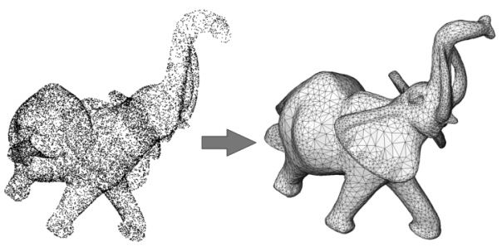
Polygonal Surface Reconstruction
Surface Reconstruction Methods
Smooth surfaces
Fit noisy data; infer topology; fill (small) holes,
Piecewise planar objects
Poisson Surface Reconstruction [Kazhdan et al. 06]

Slide 3
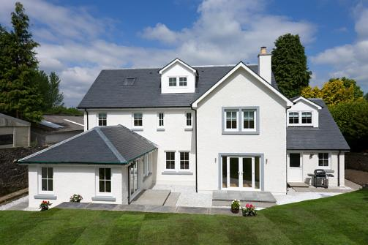
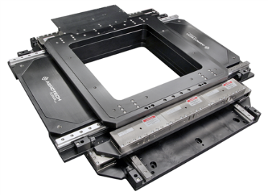
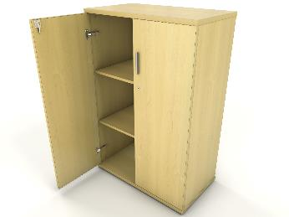
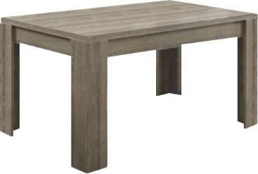
Polygonal Surface Reconstruction
Piecewise planar objects
Mostly man-made
Buildings
Mechanical parts
Furniture
…

Slide 4
Polygonal Surface Reconstruction
Surface Reconstruction Methods
Smooth surfaces
Piecewise planar objects

Slide 5
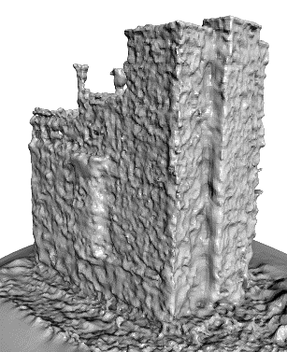
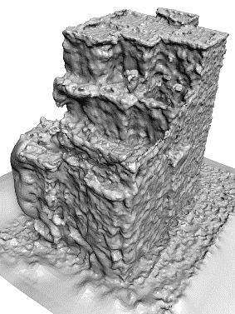
Polygonal Surface Reconstruction
Surface Reconstruction Methods
Smooth surfaces
Piecewise planar objects
330062 faces
Unsatisfied results
Bumpy
Large number of faces
Unacceptable hole filling
Rare direct applications
Post-processing required
Result of [Kazhdan et al. 06]

Slide 6
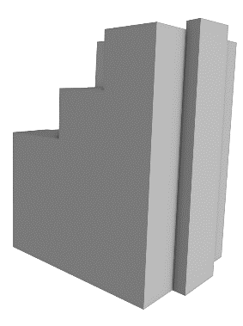
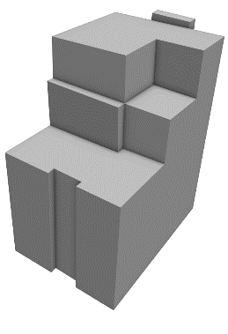
Polygonal Surface Reconstruction
Surface Reconstruction Methods
Smooth surfaces
Piecewise planar objects
Sharp features
330062 faces
25 faces
Result of [Kazhdan et al. 06]
[Nan and Wonka 17]

Slide 7
Polygonal Surface Reconstruction
Overview
Input Planar segments Candidate faces Result

Slide 8
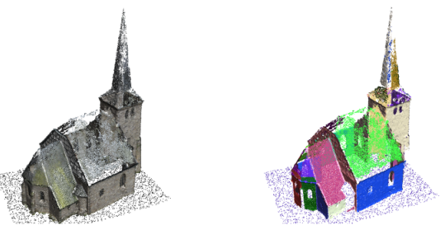
Polygonal Surface Reconstruction
Plane Extraction
Region growing
RANSAC
RANSAC algorithm
Random 3 points -> plane
Scoring, accept or reject
Repeat
Plane from the remaining points
Stop if no plane can be extracted
Input Planar segments

Slide 9
Polygonal Surface Reconstruction
Candidate Generation
Supporting plane clipping
Pairwise intersection
Input Planar segments Candidate faces

Slide 10
Polygonal Surface Reconstruction
Face Selection
Input Planar segments Candidate faces Result

Slide 11
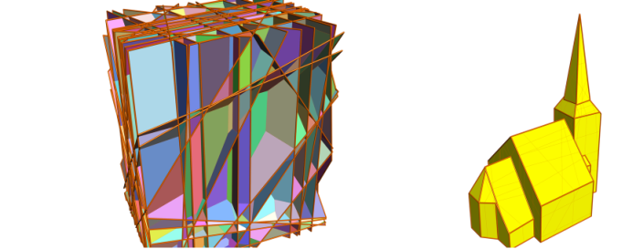
Polygonal Surface Reconstruction
Face Selection
Labeling problem
Linear integer program
Input Planar segments Candidate faces Result
$$N candidate faces F=\left\{f_{i}\right|1≤i≤N\}$$
$$face f_{i} will be chosen$$
$$Variables: x_{i}=\left\{\begin{aligned}1, \\ 0, \end{aligned}\right.$$
$$face f_{i} will not be chosen$$

Slide 12
Polygonal Surface Reconstruction
Objective Function
Data fitting

Slide 13
Polygonal Surface Reconstruction
Objective Function
Data fitting
Favors selecting faces with more support
Percentage of unused points

Slide 14
Polygonal Surface Reconstruction
Objective Function
Data fitting
Favors selecting faces with more support
Percentage of unused points
Confidence weighted
number of supporting point
Notes:
we do take into consideration the quality of the points.

Slide 15
Polygonal Surface Reconstruction
Objective Function
Data fitting
Favors selecting faces with more support
Percentage of unused points
Confidence weighted
number of supporting point
Point confidence
Notes:
Here first part (1-…) evaluates the quality of fitting a local tangent plane at p, whose value of 0 indicates
the worst point distribution and value of 1 indicates a perfectly fitted plane.
The second property l2/l3 evaluates the local sampling uniformity. Each eigenvalue ratio takes on a value in the range [0; 1] with boundary values 0 and 1 corresponding to a perfect line distribution and a uniform disc distribution correspondingly.

Slide 16
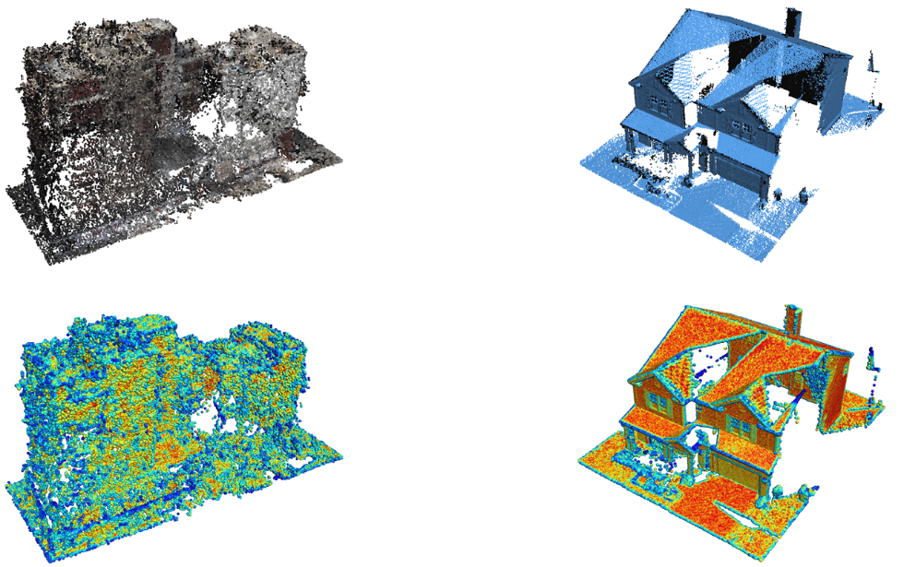
Polygonal Surface Reconstruction
Objective Function
Data fitting

Slide 17
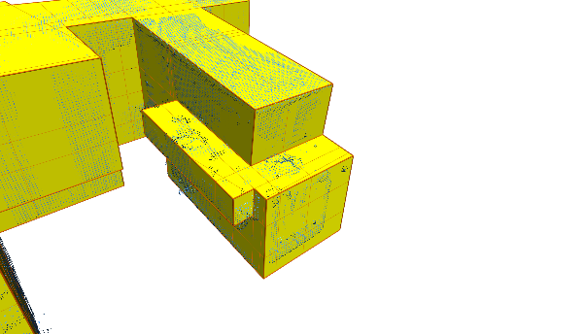
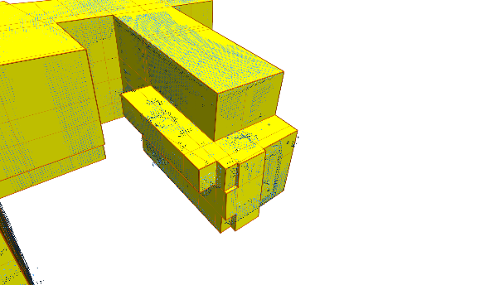
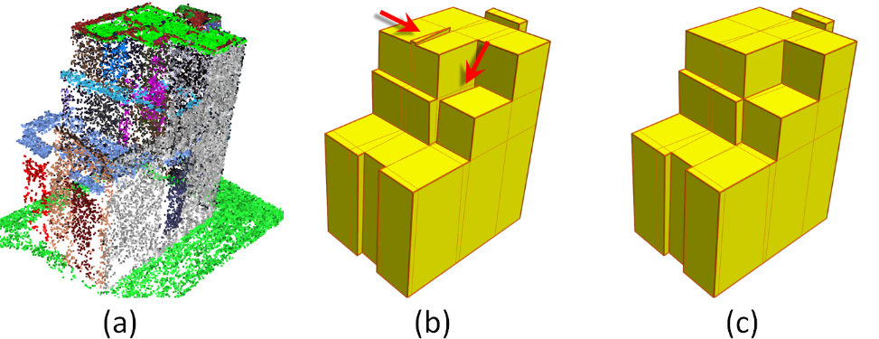
Polygonal Surface Reconstruction
Objective Function
Data fitting
Model complexity
Notes:
to penalize sharp corners.

Slide 18
Polygonal Surface Reconstruction
Objective Function
Data fitting
Model complexity
Penalize sharp corners
Notes:
to penalize sharp corners.

Slide 19
Polygonal Surface Reconstruction
Objective Function
Data fitting
Model complexity
Penalize sharp corners
Notes:
to penalize sharp corners.

Slide 20
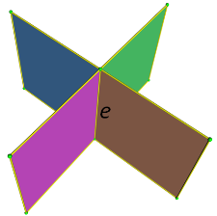
Polygonal Surface Reconstruction
Objective Function
Data fitting
Model complexity
Penalize sharp corners
Intersecting two faces
Notes:
ratio of sharp edges in the model.
It encourages large planar regions

Slide 21
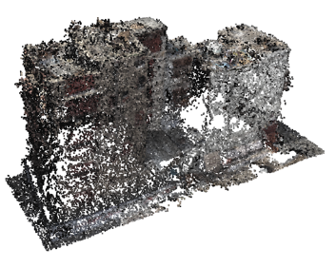
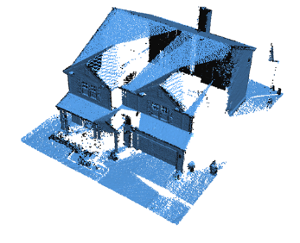
Polygonal Surface Reconstruction
Objective Function
Data fitting
Model complexity
Point coverage
Notes:
… ratio of uncovered regions in the model.

Slide 22
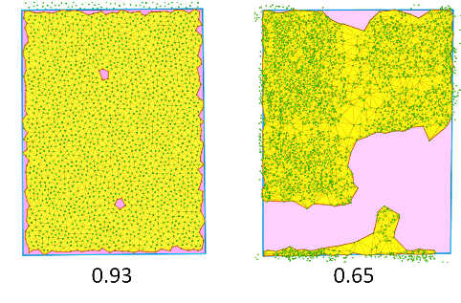
Polygonal Surface Reconstruction
Objective Function
Data fitting
Model complexity
Point coverage
Notes:
… ratio of uncovered regions in the model.

Slide 23
Polygonal Surface Reconstruction
Face Selection
Linear integer program
Data fitting
Model complexity
Point coverage
Notes:
Variables,
Each terms

Slide 24
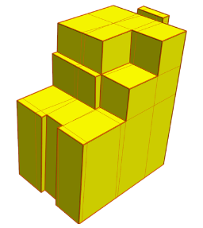
Polygonal Surface Reconstruction
Face Selection
Linear integer program
Constraints
Watertight
Manifold
Notes:
Constraints

Slide 25
Polygonal Surface Reconstruction
Face Selection
Linear integer program
Constraints
Solvers (SCIP, CBC, GLPK, Gurobi…)
Notes:
Constraints

Slide 26
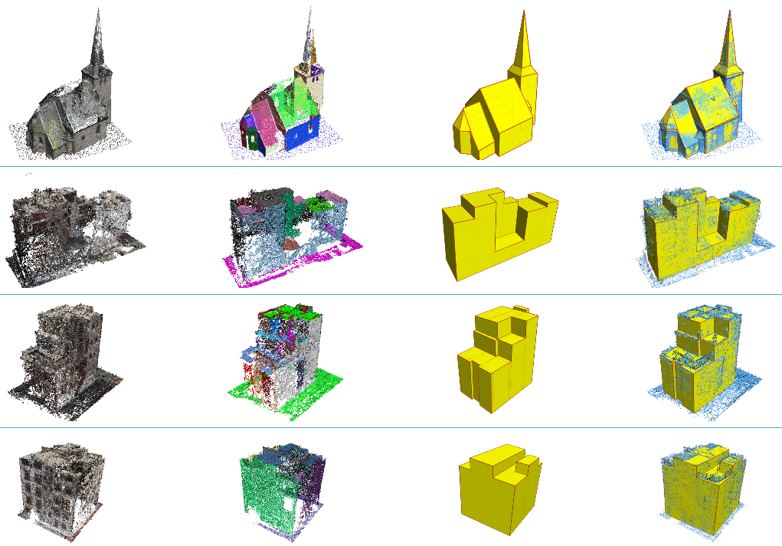
Polygonal Surface Reconstruction
Reconstruction Results

Slide 27
Polygonal Surface Reconstruction
Reconstruction Results

Slide 28
Piecewise Planar Reconstruction
Reconstruction Results

Slide 29
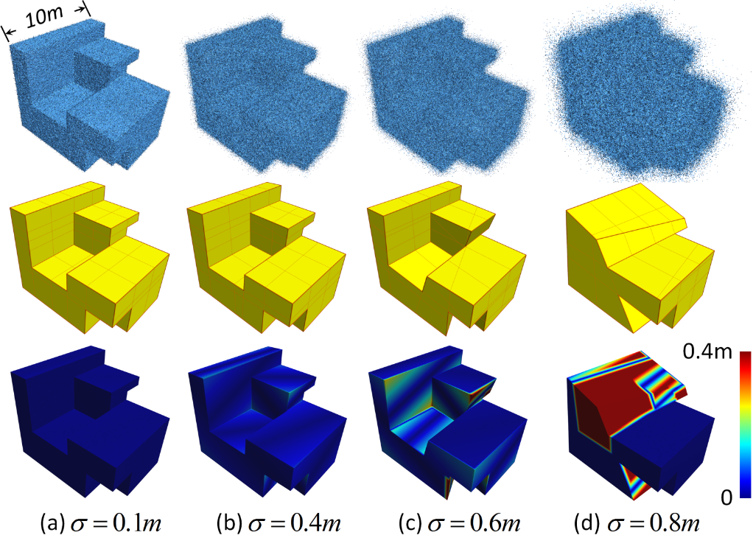
Piecewise Planar Reconstruction
Robustness to noise

Slide 30
Limitations
Object with boundaries

Slide 31
Limitations
Object with boundaries

Slide 32
Limitations
Object with boundaries
Finer surface details
Fence
Façade decorations
Door handle
…

Slide 33
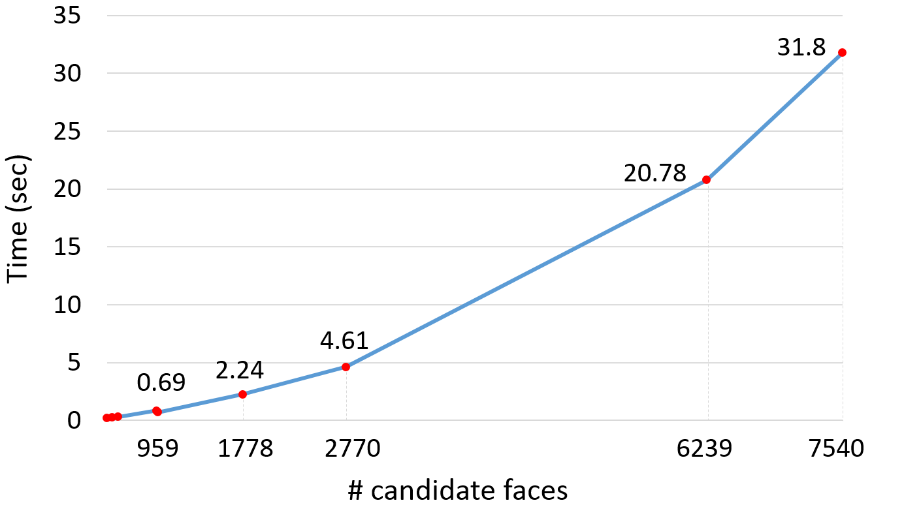
Limitations
Object with boundaries
Finer surface details
Complexity of the algorithm

Slide 34
Polygonal Surface Reconstruction
Demo
Source Code (in C++) https://github.com/LiangliangNan/PolyFit

Slide 35
Questions?

