Slide 1
Template Assembly for Detailed Urban Reconstruction
Liangliang Nan, Caigui Jiang, Bernard Ghanem, and Peter Wonka
Visual Computing Center, KAUST

Slide 2
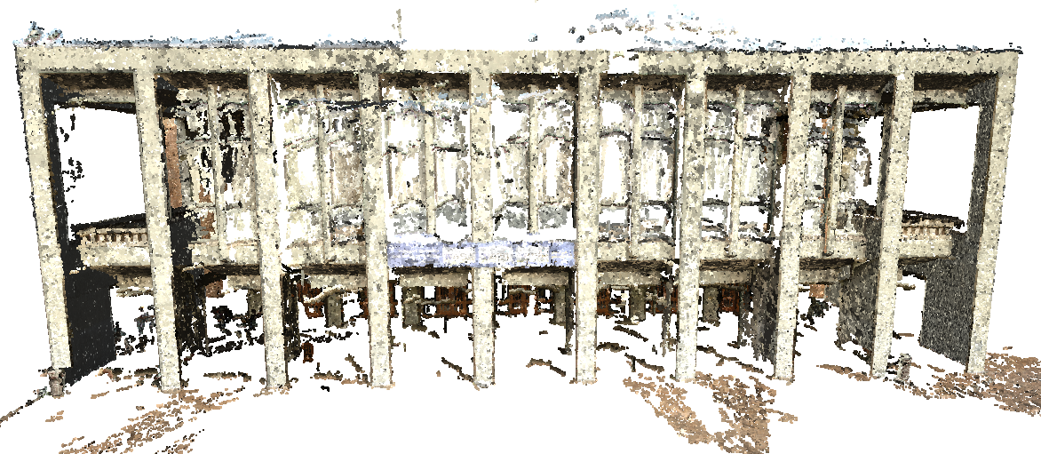
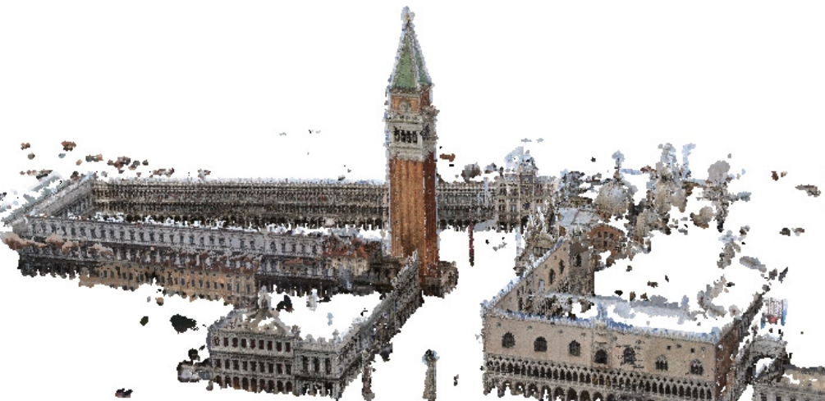
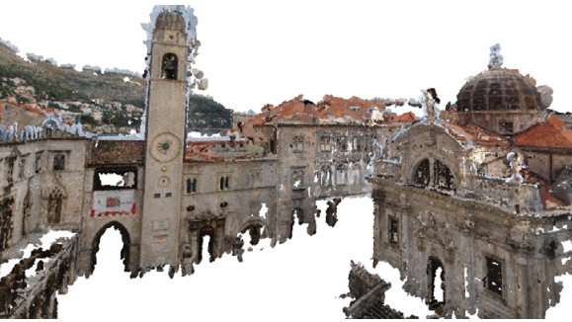
Reconstruction from Images
[Furukawa et al. 2010]
Notes:
In the last decades, the development of SfM and MVS techniques enables us to extract a colored 3D point cloud from a set of images.
While these point clouds can be rendered in an impressive manner, they are actually

Slide 3
Reconstruction from Images
Low quality
Sparse
Noisy
Incomplete
Notes:
quite sparse, noisy, and incomplete.
Let’s look at this one. To better understand the quality of the point cloud, let’s show the point cloud with uniform color, so we can focus on geometry only.

Slide 4
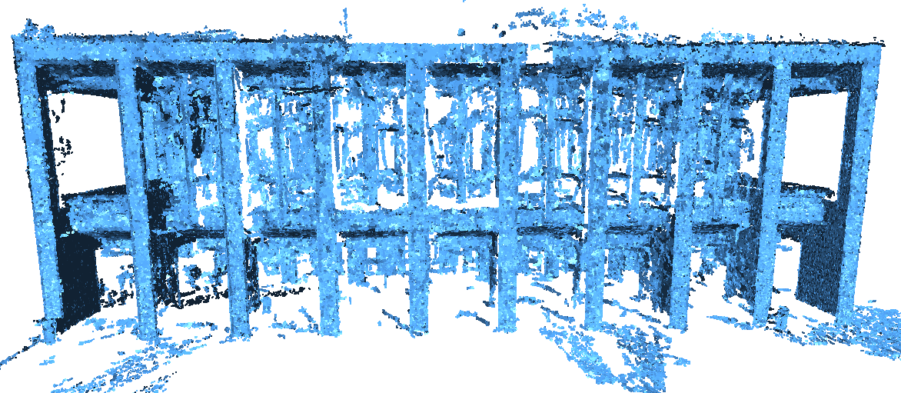
Reconstruction from Images
Recover details ?
Notes:
And… let’s zoom in to this window . I want to ask you, Can you see all the window frames? Can you generate a detailed model from this noisy point cloud? I believe most of you will say that such point cloud can only be used to build coarse models.
OK. let‘s look at corresponding photo of this window. Now you can clearly see all the details of this window. This is because the image has higher resolution.
In this work, we are trying to use image information to reconstruct detailed architectural models for point clouds.

Slide 5
Observations
Repeating façade elements Reusable 3D templates
Notes:
Now let’s look at some real world buildings.
We observe that detailed facades elements are usually repeating within and among facades. This is true especially for buildings in a community that are constructed by the same developer.
This observation motivates us to develop techniques that can assemble reusable detailed 3D elements onto coarse models. In our work, we call a 3D façade element a template.

Slide 6
Observations
Repeating façade elements
Piecewise Planar façades Problem reduced to 2D
Notes:
Another observation is that most buildings have piecewise planar facades.
With this assumption, the assembly of geometric details in 3D space can be reduced to choosing appropriate 3D templates and detecting their locations in 2D image space.

Slide 7
Goal: Detailed 3D Model from Images Strategy: Exploiting Image Information
Notes:
In this work, we are interested in bring more facade details into the image-based urban reconstruction pipeline. Our strategy relies on image information.

Slide 8
Related Work
Hot topic
Large number of tools and methods
[Vanegas et al. 09; Musialski et al. 09 etc.]
Notes:
Before going to the technical parts, let’s have a quick review of some related work.
- The reconstruction of urban models has been a hot topic in both computer graphics and computer vision.
Quite a few tools and methods have been developed for analyzing and reconstructing architectural models.
However,

Slide 9
Related Work
Hot topic
Large number of tools and method
Coarse model only
Facades are large textured polygons
[Xiao et al. 09; Vanegas et al. 10, 12; Zhou & Neumann 12, 13; Lin et al. 13; …]
[Xiao et al. 09]
Notes:
most of the these work focus on generating coarse models where facades are approximated by large textured polygons.

Slide 10
Related Work
Hot topic
Large number of tools and method
Coarse model only
Facades are large textured polygons
Manual editing is required
[Xiao et al. 08; Arikan et al. 13]
[Arikan et al. 13]
Notes:
Even the automatic generation of coarse models is not robust and typically requires manual editing.

Slide 11
Related Work
Hot topic
Large number of tools and method
Coarse model only
Facades are large textured polygons
Manual editing is required
Practice: almost completely manually
Notes:
So in practice, facade details are reconstructed almost completely manually.
Now, let me introduce how we can make this task semi-automatic.

Slide 12
Overview
Input: Ground-level images
Pre-processing (existing techniques)
Point cloud generation
Coarse model construction
3D templates generation
Notes:
The input of our framework is a set of ground level images.
In a preprocessing step, we extract a 3D point cloud from these images using SfM and MVS. Then, we construct coarse models and a set 3D templates using our interactive tools.
These videos show how we interactively construct a coarse model and a 3D template.
The preprocessing step mainly relies on existing techniques, so in the following I will only focus the core techniques of our work.

Slide 13
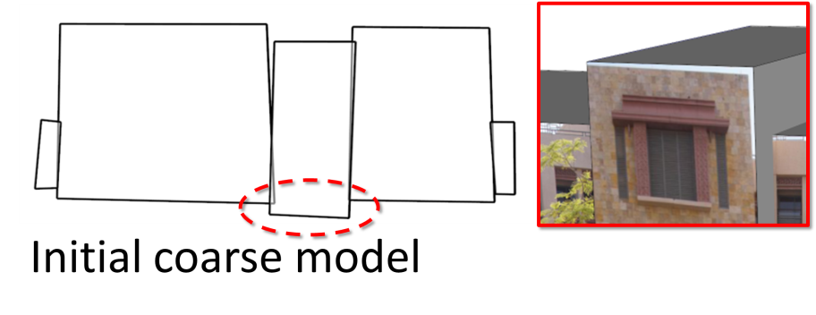
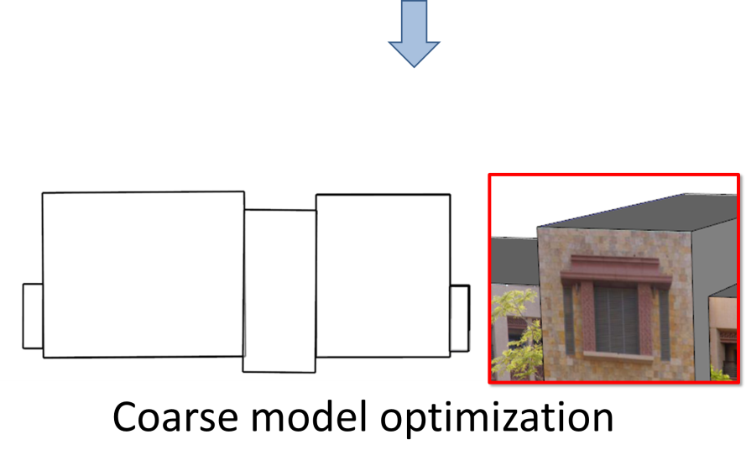
Overview
Notes:
We first exploit image information to optimize the coarse model.
The goal of this task is to make sure the images are rectified and are well aligned with the coarse model.
Then, we rely on images

Slide 14
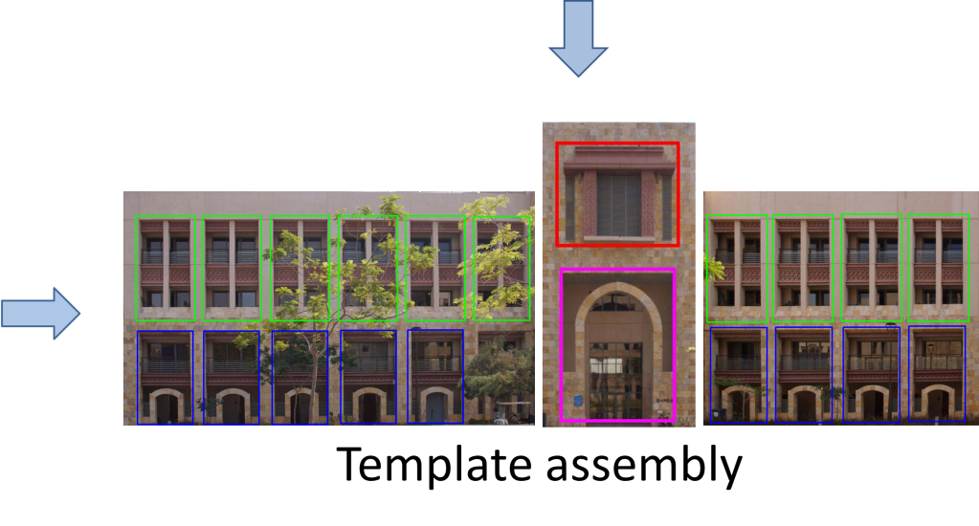
Overview
Notes:
to assemble 3D templates onto the coarse model.
We detect and optimize template locations in the images of the coarse model.
Finally, the detailed 3D templates

Slide 15
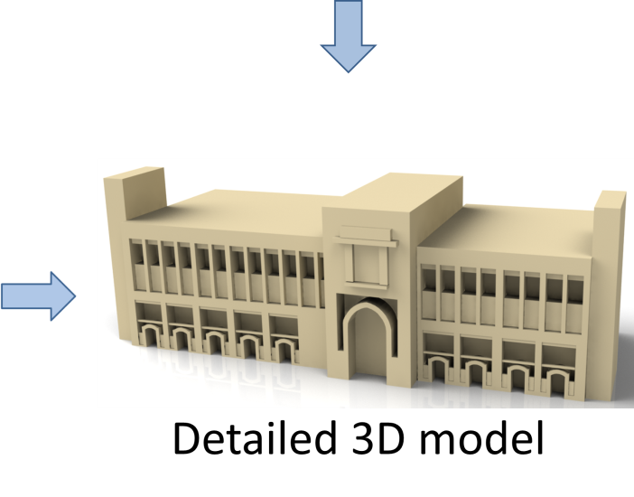
Overview
Notes:
are transformed onto the coarse model using the camera parameters estimated in SfM step.
Now let’s go to the details of each part.

Slide 16
Coarse Model Optimization
Initial coarse model
Textures are not aligned
Model has gaps and overlaps
Notes:
Given the coarse model reconstructed in the pre-processing step, you can see the texture images are not well aligned with the model, and the model has gaps and overlaps.
These irregularities

Slide 17
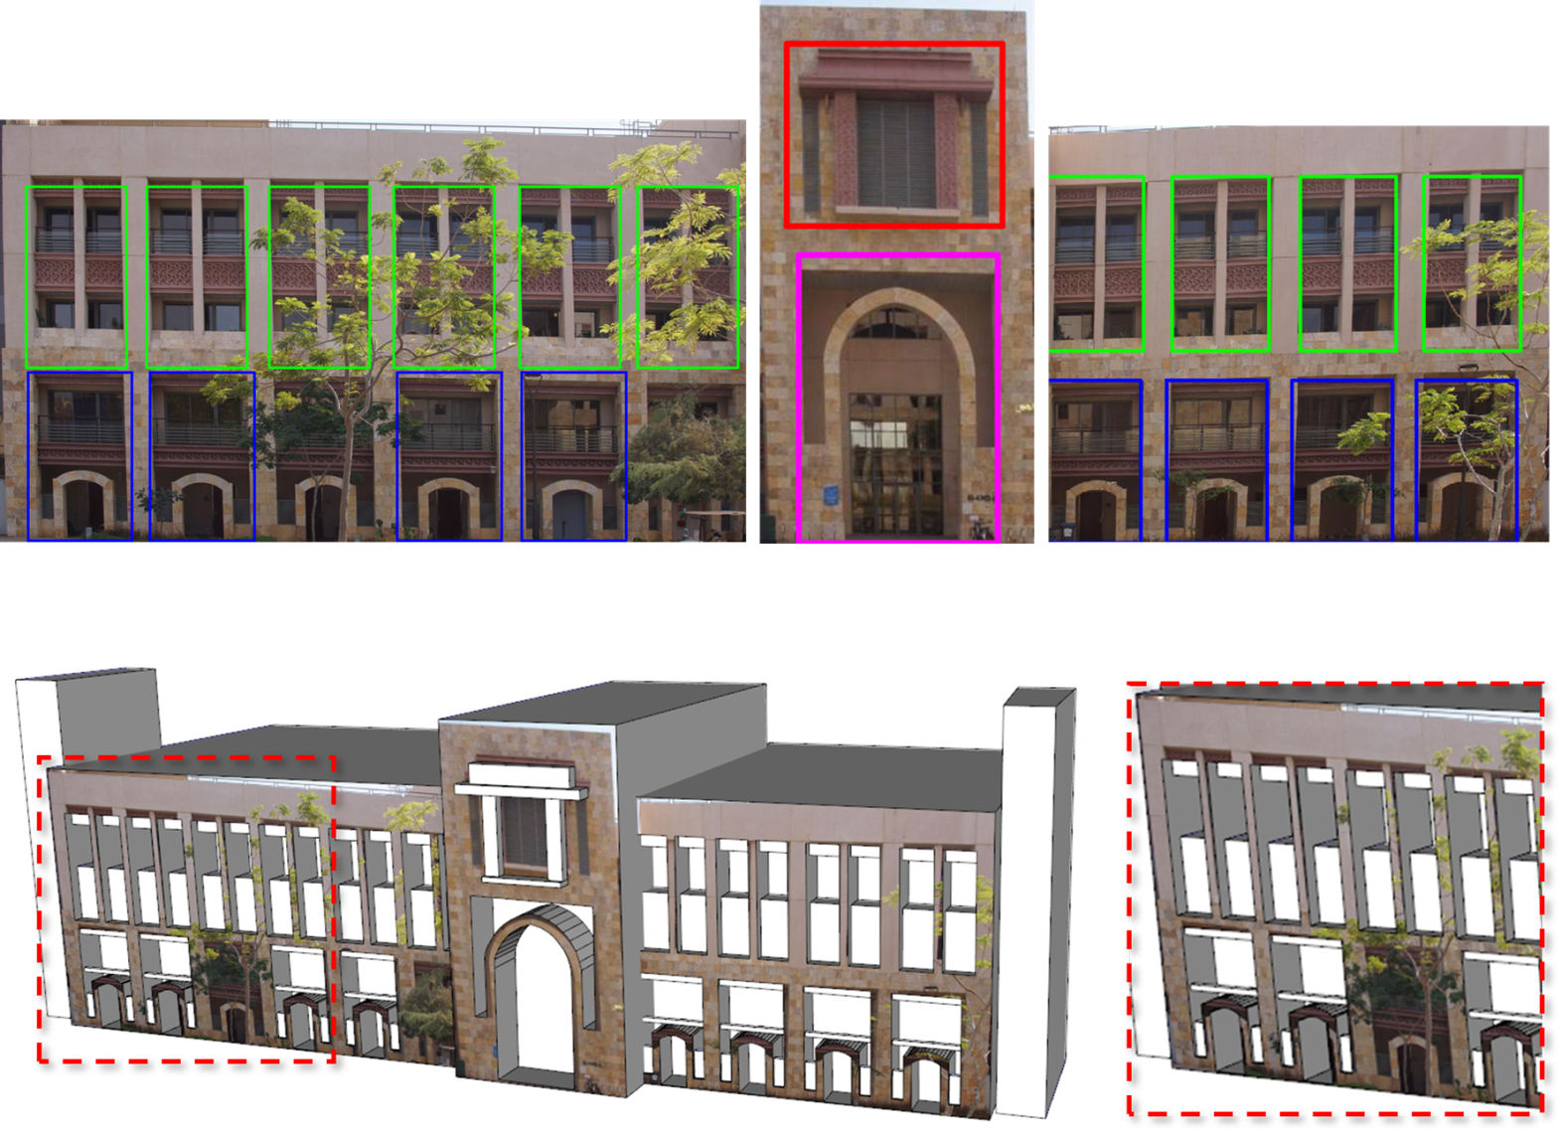
Coarse Model Optimization
Problems
Missing detection
Misalignment
Optimization
Geometry
Appearance
Notes:
usually result in missing detection and misalignment in the ﬁnal 3D model.
To tackle these problems, we propose an approach to optimize both the geometry and appearance of the coarse model.
Our energy is the weighted sum of the following terms:

Slide 18
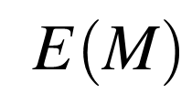
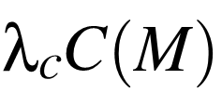
Coarse Model Optimization
Energy
Geometry-appearance consistency
(Face-image alignment)
Model edge
Image segment
Notes:
The Geometry-appearance consistency term measures how well the projection of all the model’s faces align with the corresponding image regions .
With the camera parameters recovered by SfM, each line segment in the image corresponds to a plane in the 3D space. Thus, we define this term as the sum of squared distances between the face edge and the 3D plane.
Generally, this term favors face-and-image alignment.

Slide 19
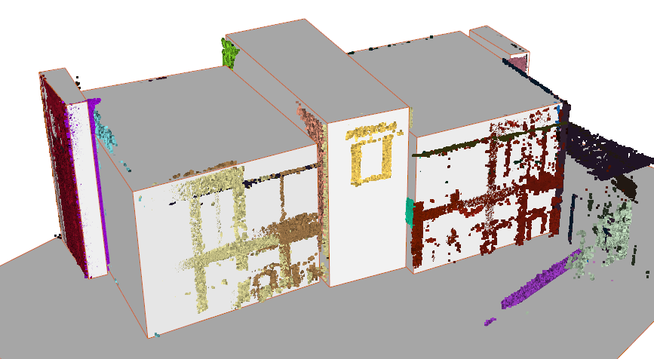
Coarse Model Optimization
Energy
Data fidelity
Notes:
The second term is the Data Fidelity Term, that measures how well the faces of the coarse fit to the point cloud. Thus it prevents the model from ‘deviating too much from the point cloud.
Speciﬁcally, it is defined as the sum of squared distance between a vertex in the model and the corresponding plane detected in the point cloud.

Slide 20
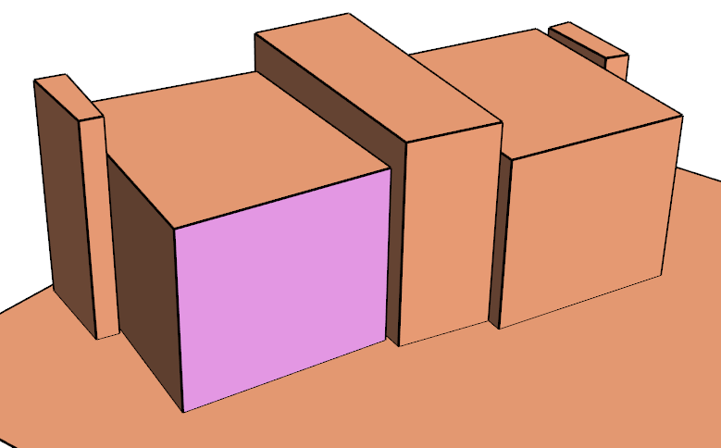
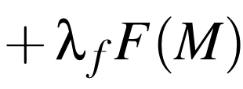
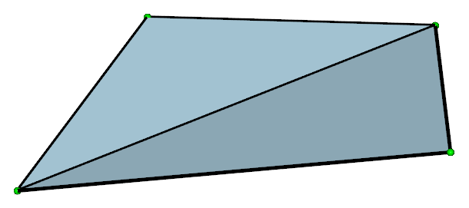
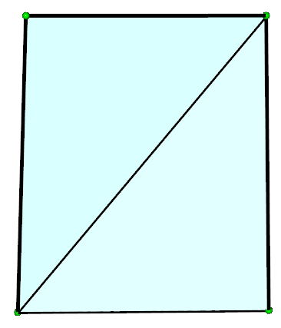
Coarse Model Optimization
Energy
Face geometry
planarity
orthogonality
Notes:
The Face Geometry Term enforces a face in the model to be planar, and adjacent edges of the face to be orthogonal.

Slide 21
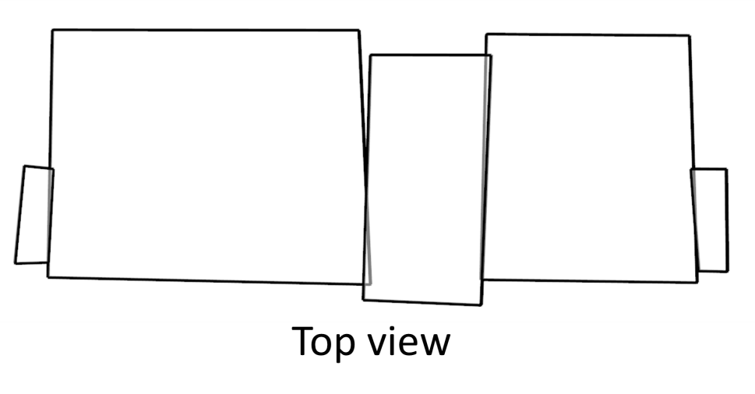
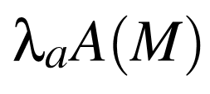
Coarse Model Optimization
Gaps and intersections
Energy
d₁
Face alignment
f_{i}
f_{j}
d₂
Notes:
To handle gaps and intersections between adjacent boxes, our face alignment term is defined as the sum of the bidirectional distance between face pairs.
Here we only consider pairs of faces that are close to each other and have overlap when one is projected onto the other.

Slide 22
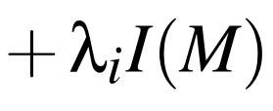
Coarse Model Optimization
Energy
Initial geometry
Notes:
In order to avoid drastic deformation, we add an initial geometry term, which penalizes the overall magnitude of the deformation.
Mathematically, it is defined as the sum of squared distances between a vertex and its initial position.

Slide 23
Coarse Model Optimization
Energy minimization
Levenberg-Marquardt method [Devernay 2010]
Geometry-appearance consistency
Data fidelity
Face geometry
Face alignment
Initial geometry
Notes:
By putting all this terms together, we have a nonlinear least-squares problem. The energy can be efficiently minimized using the Levenberg-Marquardt method.
By minimizing this energy

Slide 24
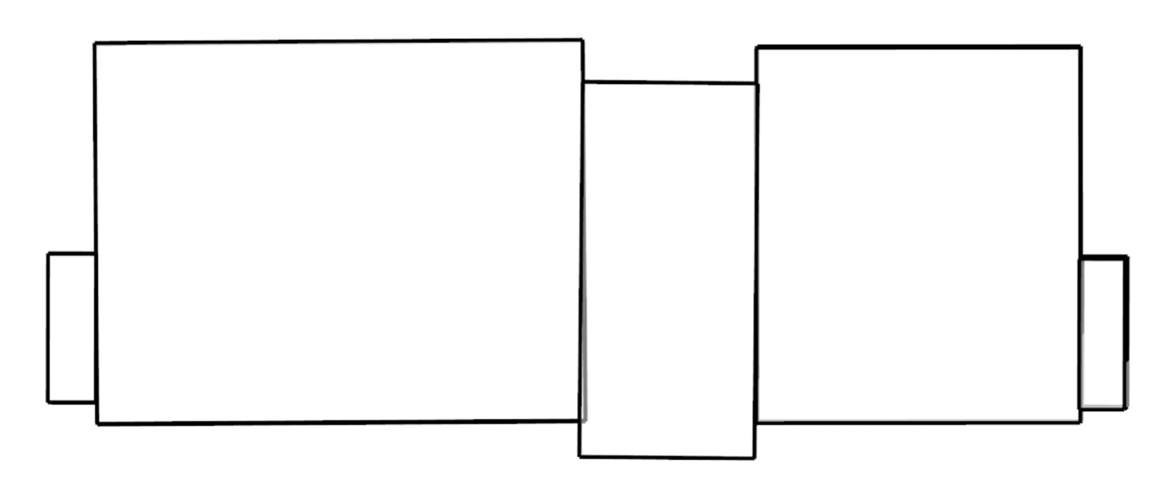
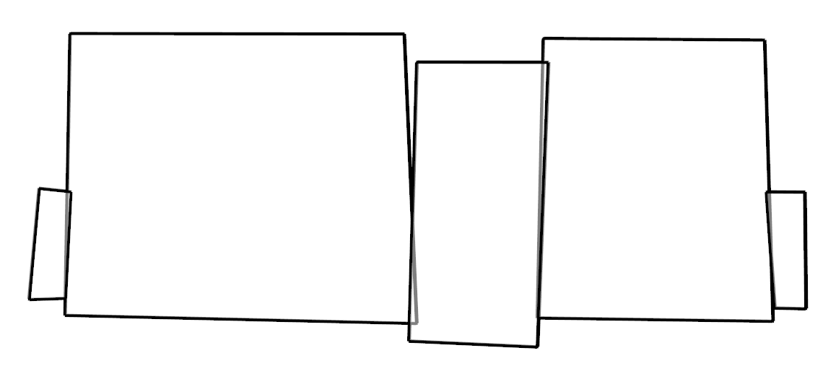
Coarse Model Optimization
Before optimization
After optimization
Top view
Notes:
both the geometry and texture of the model are improved. Here shows the model before and after the optimization in top-view.
You can see the gaps and overlaps have are resolved.

Slide 25
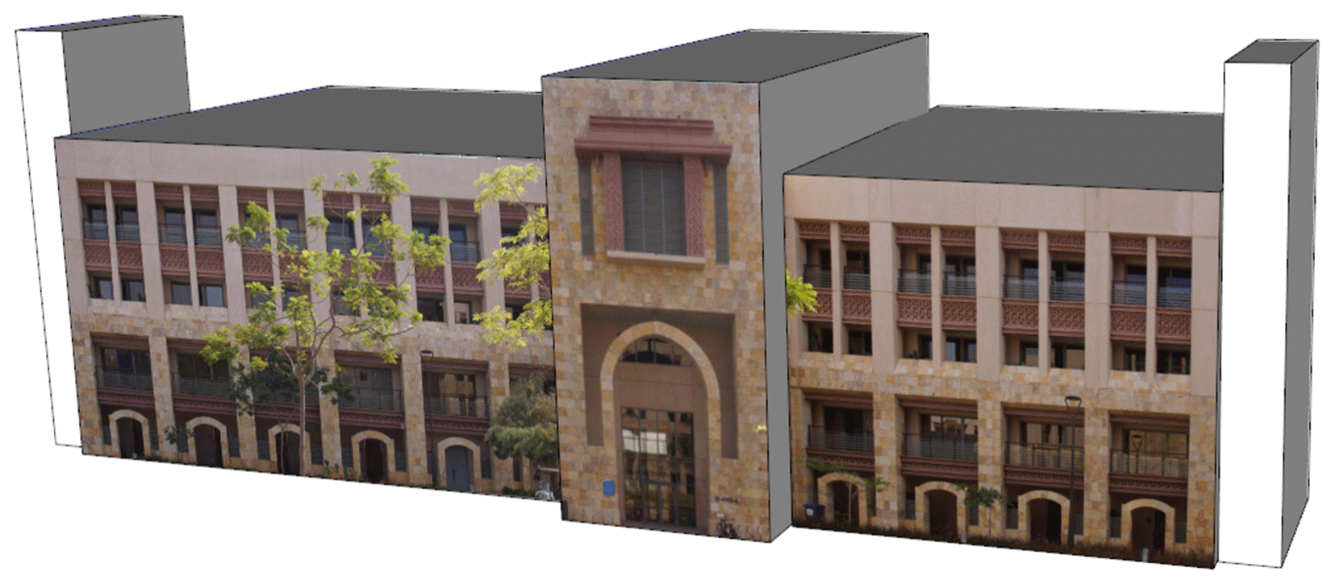
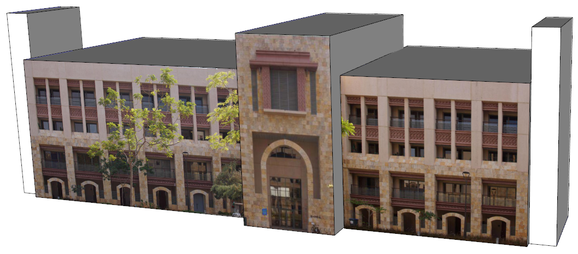
Coarse Model Optimization
Before optimization
After optimization
Front view
Notes:
And here shows the front view. You can see now the textures are well aligned with the model.
With the improved texture images,

Slide 26
Template Assembly
Notes:
now it is time to assemble templates.

Slide 27
Template Assembly
Directly in 3D space ?
Sparse,
Noisy
Incomplete
In image space
3D template assembly 2D detection in image space
Notes:
Since the point clouds generated from SfM and MVS are usually sparse, noisy, and incomplete. It is quite challenging to assemble the 3D templates directly in 3D space.
In our work, we rely on images to perform this task.

Slide 28
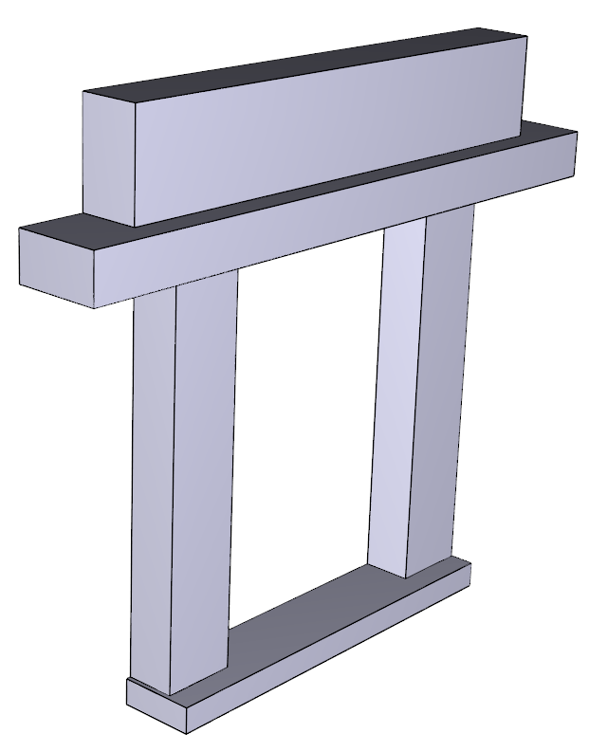
Template Assembly
A template = 3D geometry + Query key
Notes:
When the detailed 3D templates are built in the preprocessing step, we associate each of them with the image region where is was built.
This image region can be used as a query key to locate the same elements in the images of other facades.

Slide 29
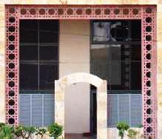
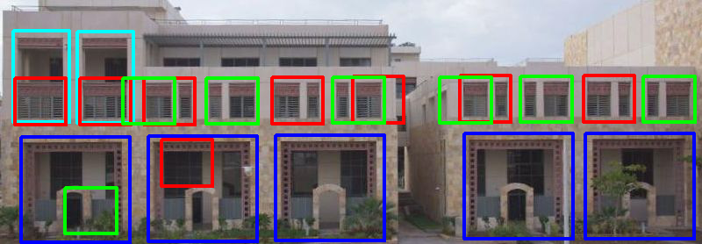
Template Assembly
Histogram of Oriented Gradients (HOG)
Key images
Candidates
Notes:
To do this, we first detect a set of candidate locations based on the HOG descriptor.
As you can see from this example, even for only 4 templates, there are false detections, and the locations of different templates may overlap.
One possible way

Slide 30
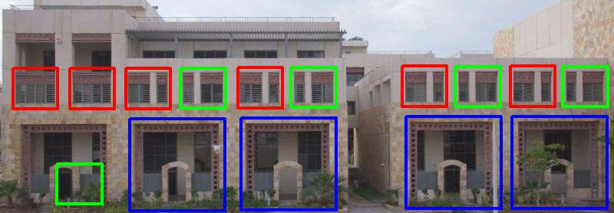
Template Assembly
Greedy detection ?
Key images
Greedy
Detection
Notes:
to resolve this overlap problem is by performing the detection in a greedy manner. That means, we only keep the template that has the highest score.
However, the highest scores do not always suggest appropriate templates. This is typically true when we have a larger number of templates.

Slide 31
Assembly Optimization
Seek help from structural regularities
- Candidate selection as optimization
Notes:
So we seek help from structure properties of facades.
We exploit structural regularities of the façade and we formulate the template selection as another optimization problem.
We ﬁrst generate

Slide 32
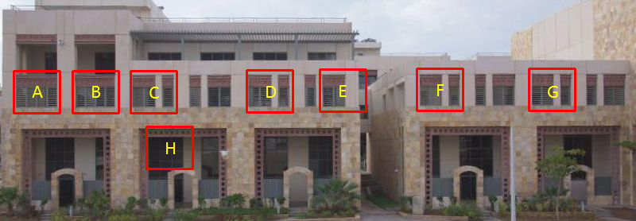
Assembly Optimization
Seek help from structural regularities
Restricted power set of potential groupings
E.g.
Template
Notes:
a restricted power set of potential groupings of the initial detections.
Now the problem becomes choosing a subset of the potential groups that minimizes the following energy:

Slide 33
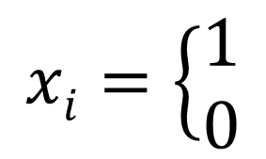
Assembly Optimization
Template matching
Regularity
Image coverage
$i$_{th} group chosen
$i$_{th} group not chosen
Notes:
Here the variable X denotes the binary labels for all candidate groups.
The value 1 of xi suggests the ith group is taken.
Now let me explain our energy terms.

Slide 34
Assembly Optimization
Template matching cost
- average matching score of group
Notes:
The first term is the template matching cost term, which measures the overall matching conﬁdence for the entire façade.

Slide 35
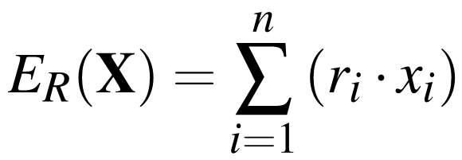
Assembly Optimization
Regularity cost
- regularity of group .
Maximum variance of interval and alignment
Notes:
The second term encodes regularity, that encourages regular patterns in the facades.
The regularity of a group is deﬁned as the maximum variance of interval and alignment of the group.

Slide 36
Assembly Optimization
Image coverage
Notes:
The third term is designed to encourage covering more of the image area by templates.

Slide 37
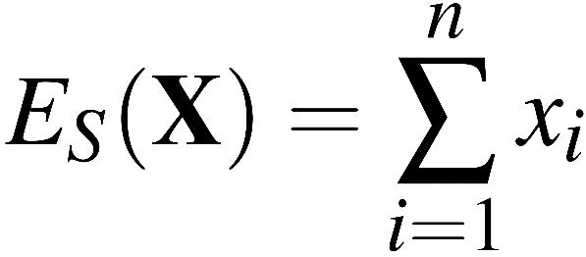
Assembly Optimization
Sparsity
Notes:
In order to represent the façade using a minimum number of groups, we add a sparsity term.
This term is defined as the number of template groups that are chosen to represent the facade.

Slide 38
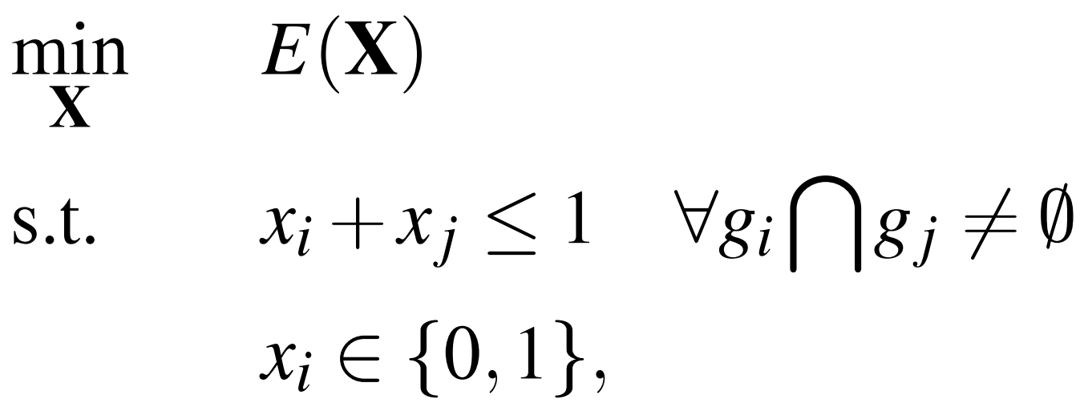
Assembly Optimization
Energy minimization
Non-overlap constraints
Notes:
Now, the appropriate template groups can be determined by minimizing this objective function. We have constraints that groups are not allowed to overlap with each other.
Minimizing this energy is a Linear Integer Programming problem that can be efficiently solved using various open source solvers.

Slide 39
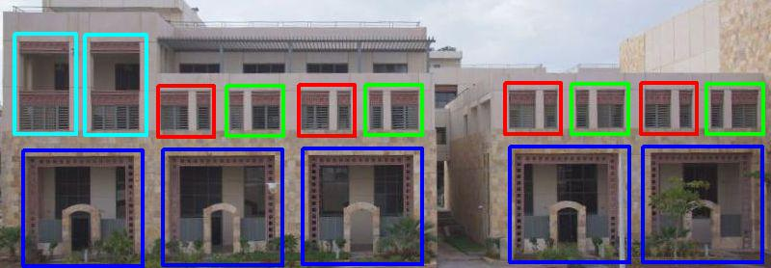
Assembly Optimization
Notes:
Here shows the optimization result for the example mentioned in previous slides.
As you can see, we now we have good template detection and locations. And it is ready to assemble 3D geometry onto the coarse model.

Slide 40
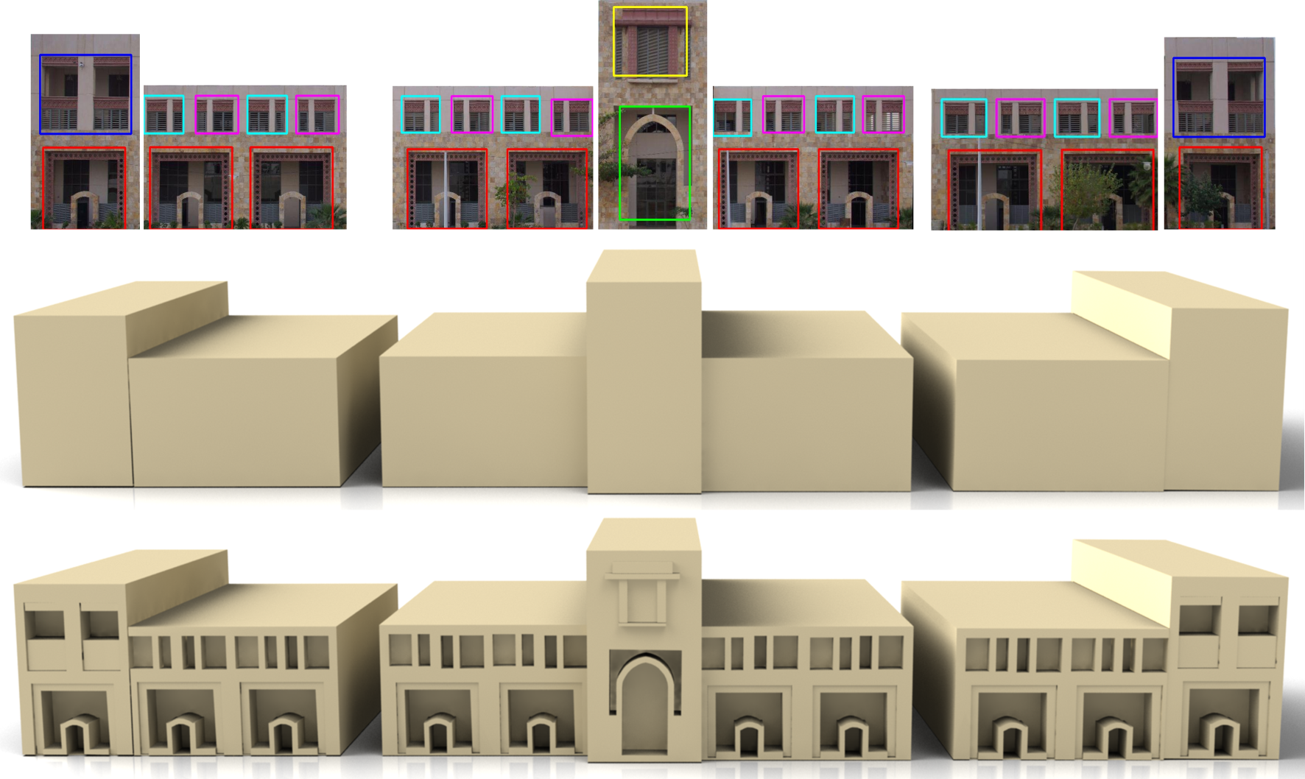
3D Assembly
Back-projection
110 images
Notes:
The locations of 3D templates can be determined by projecting these 2D locations onto the coarse model using the camera parameters recovered in the SfM step.
As a result, we get a detailed 3D model.

Slide 41
Results
281 images
387 images
Notes:
Here, although the 4 buildings have different coarse models, they share the same façade detailes.
Therefore, they are enhanced with details using the same set of 3D templates.

Slide 42
Results
Realism improvement
Notes:
In this slide, we show the textured version of one the reconstructed buildings.
As you can see, by adding more details into the coarse model, the realism has been signiﬁcantly improved.

Slide 43
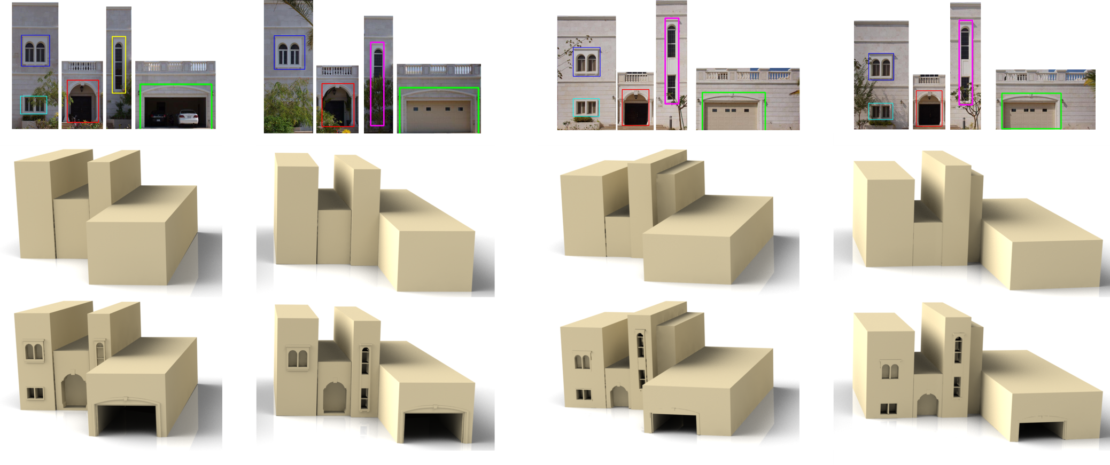
Results Façades without repetitive elements
220 images
Notes:
Our method also works for façades that have no repetitive elements. But the same elements are repeating among different buildings.
Here shows 4 buildings of another style. We build another set of templates to perform our automatic template assembly.

Slide 44
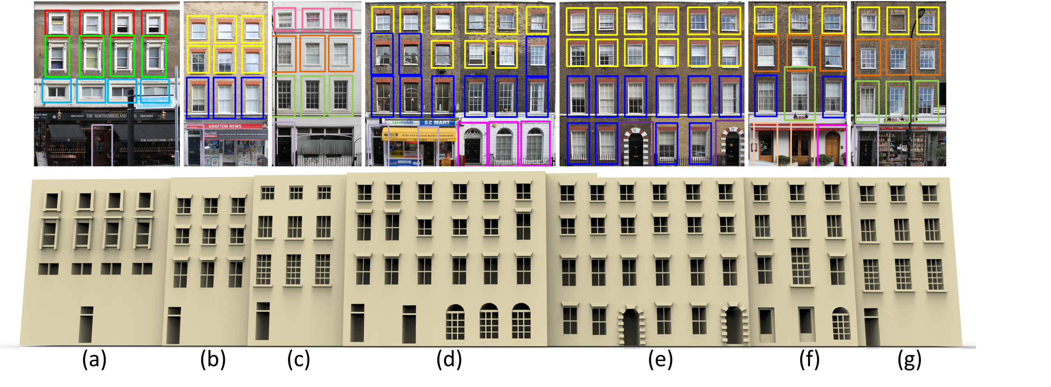
Results Street-side facades reconstruction
Notes:
In this slide, we show the detailed reconstruction of several street-side facades from European cities.

Slide 45
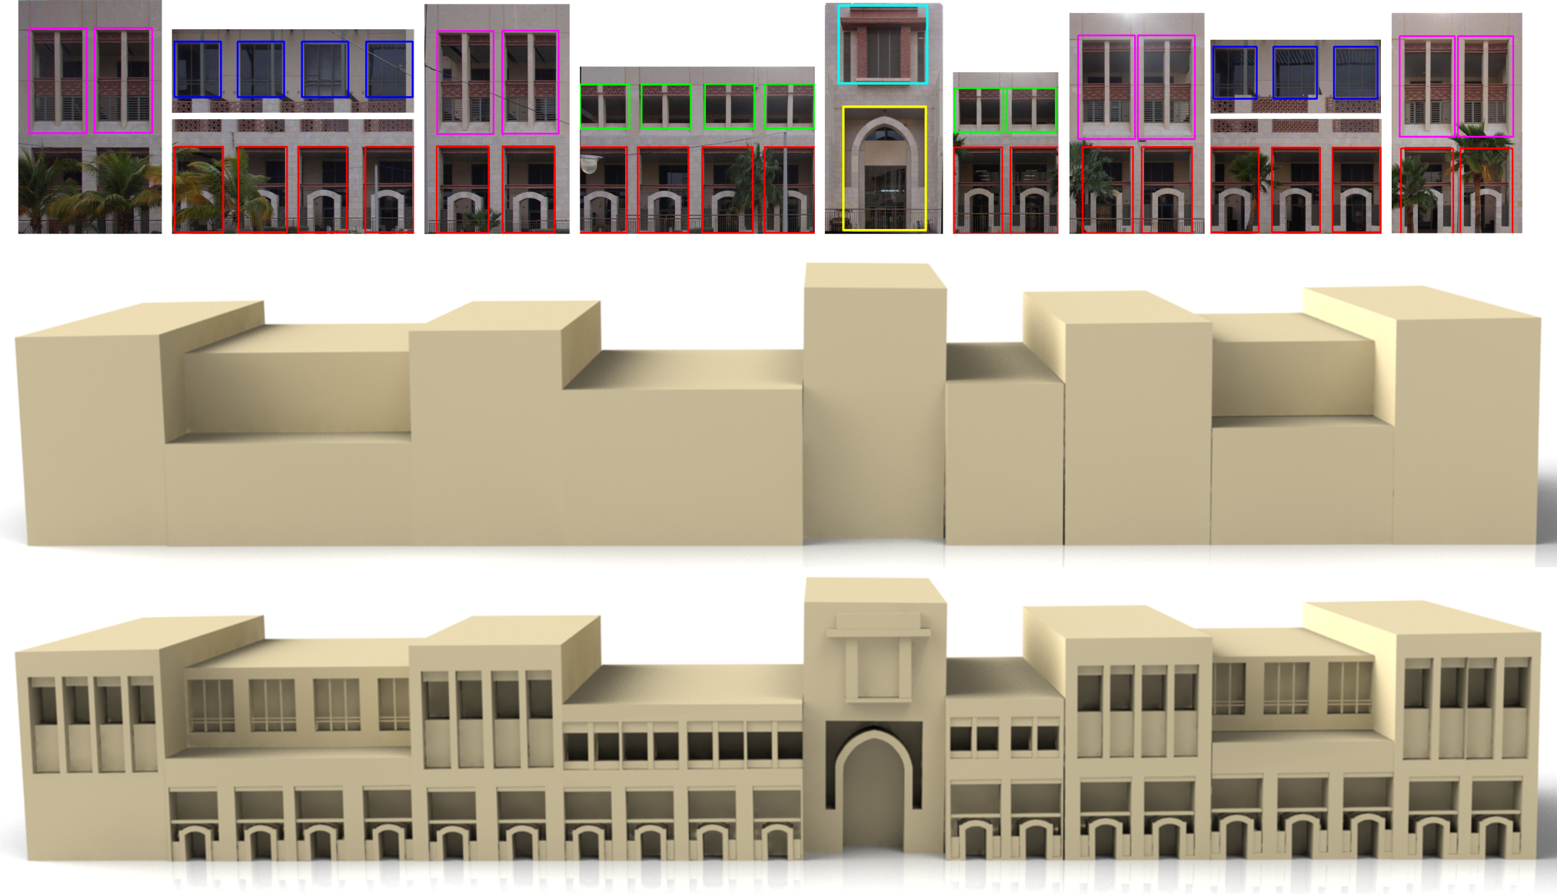
Failure Case
Notes:
For this building, since there are severe occlusions, our method failed to detect two doors in the left façade. So we can not recover the details for them.

Slide 46
Comparison
Ours Greedy Mutual Information
Notes:
We conducted visual comparison of our optimization-based template assembly with two competing methods: greedy and mutual information. Here show an example. For more visual comparison please refer to the supplementary material of our paper.
We also conducted quantitative comparison by applying these methods to 24 facades in our data set. The assembly score is measured as the ratio of the overlap area between the automatically detected templates and the manually marked ground truth to their union.
The comparison shows that the greedy method is prone to produce false template instances and that Mutual Information is not competitive in detecting the correct template locations, while our optimization-based method performs the best among the three.

Slide 47
Geometry-appearance Consistency Is Important
Without
With
Notes:
In this slide, we show a comparison of the template assembly without and with our Geometry-appearance Consistency term in the coarse model optimization step.
You can see omitting this term results in more false detections, and more misalignment in the final model. Our geometry-appearance optimization step leads to more consistent geometry, better localized template detections, and a more accurate detailed model.

Slide 48
Limitations
Non-repeating elements
Curved facades
Notes:
Of course, our method has some limitations. Our template assembly framework is suitable for reconstructing a set of buildings that demonstrate repeating elements.
- When there is no repetitions, we lose the advantage of reusable templates. That means all elements are required to be constructed manually.
- Another limitation is that currently we can only handle buildings with piecewise planar facades.

Slide 49
Conclusion
An efﬁcient urban reconstruction framework
Relies on image information + Prior knowledge
Geometry-appearance consistency of coarse model
Template assembly
Notes:
OK now, let me conclude my talk.
We present a framework that can efficiently reconstruct detailed urban models. Our method relies on image information in two key steps.
First, we use it to improve geometry, appearance, and their consistency of the coarse models.
Second, we use it to detect templates locations on the facades.
We incorporate prior knowledge about facades into both steps. This leads to an effective urban reconstruction framework.

Slide 50
Future Work
Enhance existing coarse models
- Google Earth models
Vegetation detection

Slide 51
Thank you!

Slide 52
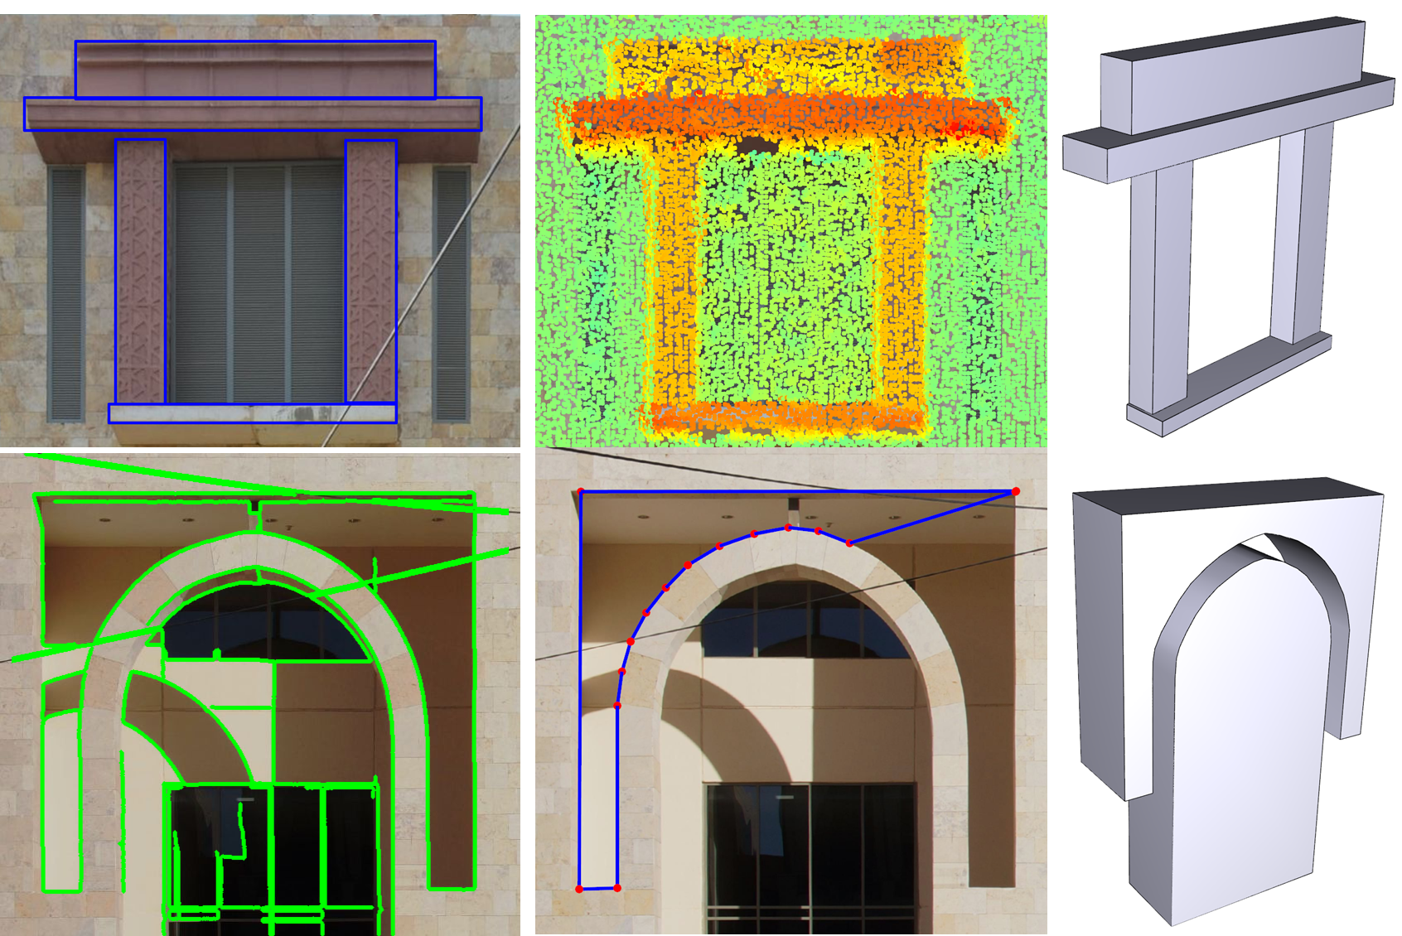
Template Construction

