Slide 1
Conjoining Gestalt Rules for Abstraction of Architectural Drawings Liangliang(Leon) Nan¹, Andrei Sharf², Ke Xie¹, Tien-Tsin Wong³ Oliver Deussen⁴, Daniel Cohen-Or⁵, Baoquan Chen¹ ¹ SIAT, China ² Ben Gurion Univ., Israel ³ CUHK, China ⁴ Konstanz Univ., Germany ⁵ Tel Aviv Univ., Israel
Notes:
Hello, I am Lianliang Nan from Shenzhen Institutes of Advanced Technology, Chinese Academy of Sciences. I will present our work: Conjoining Gestalt Rules for Abstraction of Architectural Drawings

Slide 2
Abstraction of Architectural Drawings
Notes:
Our motivation is to simplify the drawings by modeling conjoining Gestalt.
I will explain what is Gestalt, what is conjoining Gestalt, and how we model it.

Slide 3
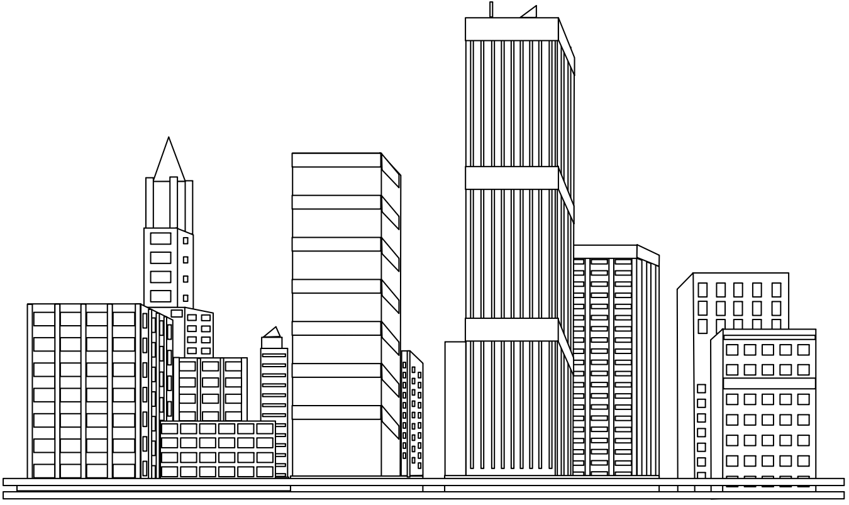
Abstraction of Architectural Drawings
Notes:
Here shows a preview of our results.
Look, even we zoom out, we can still observe the main structures of the buildings.

Slide 4
How Our Visual System Simplifies Things
How we get the idea?
Notes:
Before we start, I want to explain how we get the idea for this work.
Essentially we want to simplify drawings following the human visual system.
Let’s do a simple experiment for how our visual system simplifies things.

Slide 5
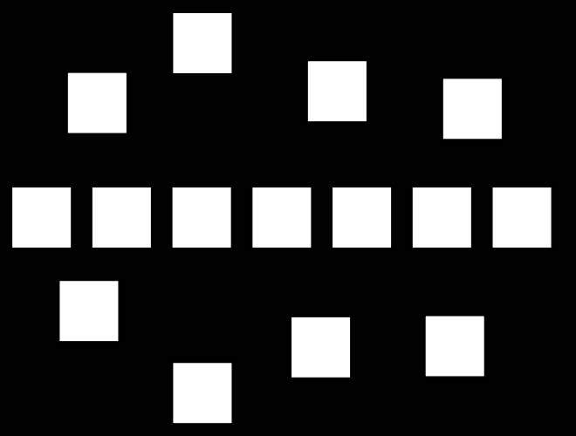
How Our Visual System Simplifies Things
Notes:
Look at this figure, what happens when I zoom out? (click)
How your visual system simplifies the figure?
It is quite simple. I think most of you will find the grouping like this (click).

Slide 6
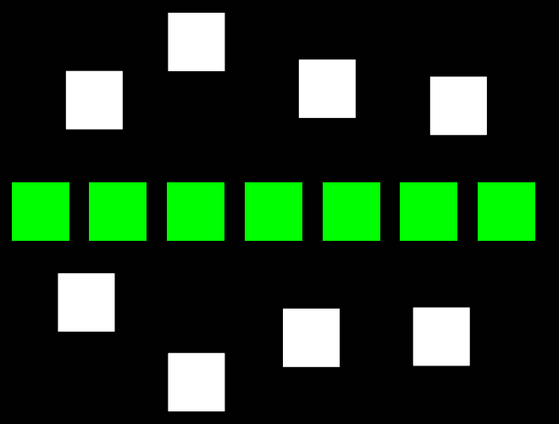
How Our Visual System Simplifies Things
Regularity
Notes:
The grouping has very clear regularity.
Now let’s make it a little bit more complex (click).

Slide 7
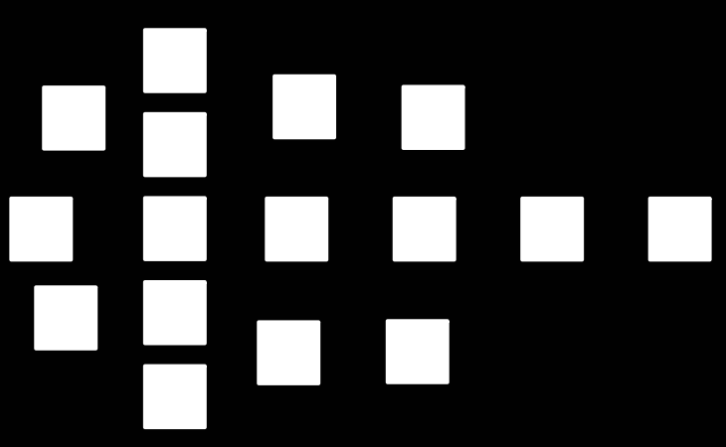
How Our Visual System Simplifies Things
Notes:
How can you group and simplify this one?
Some of you may group in horizontal (click), others in vertical (click).
Both groupings make sense, so the question is Is their a more dominant grouping.

Slide 8
How Our Visual System Simplifies Things
Gestalt – grouping → simplification
Notes:
In psychology, these groupings of the visual system are called Gestalt.
When seeing far from the objects, or we zoom out, our visual system groups elements together and simplifies the scene.
We zoom out (click) … zoom out more (click)…
I believe most of you feel the vertical grouping demonstrates stronger proximity.
Like this.

Slide 9
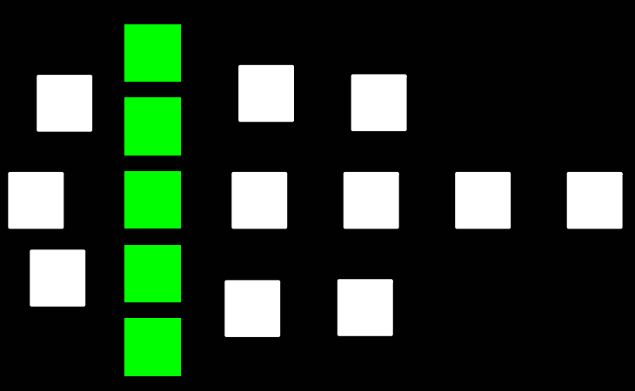
How Our Visual System Simplifies Things
Proximity

Slide 10
How Our Visual System Simplifies Things
Similarity
Notes:
And for this example, because of stronger shape similarity, most people will find groupings in this way(click),
All these examples showed how our visual system simplifies things, and how one grouping is more dominant when there are ambiguities.

Slide 11
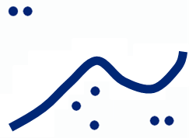
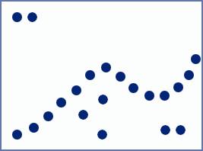
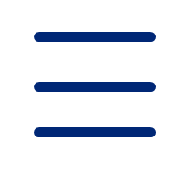
Gestalt Theory
Several principles
Group objects into forms
Create internal representation [Wertheimer 1923]
Continuity Gestalt
Proximity Gestalt
Notes:
In psychology, the Gestalt Theory explains this visual phenomenon.
Gestalt theory contains principles of how human visual system groups objects together.
(click) Here in this figure, the horizontal intervals between the blue dots are smaller than those in vertical direction, so our visual system tends to group the elements in horizontal direction.
(click) Another example, we find a continuous curve in this figure by continuity Gestalt.

Slide 12
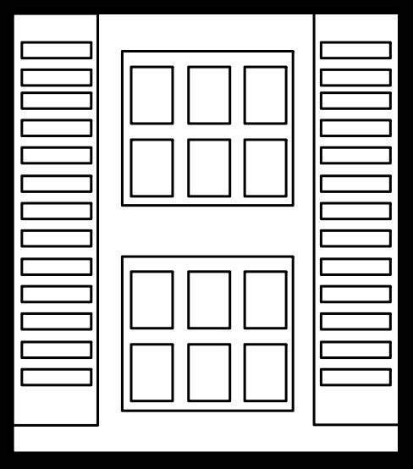
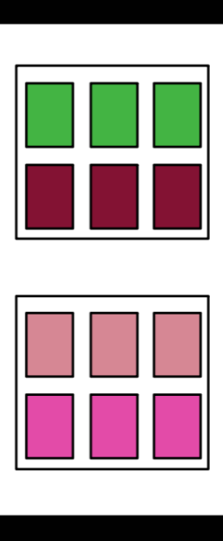
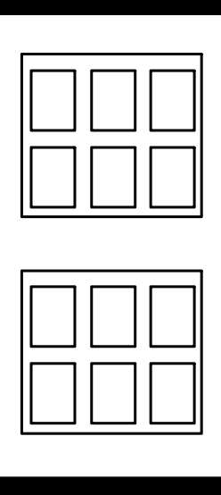
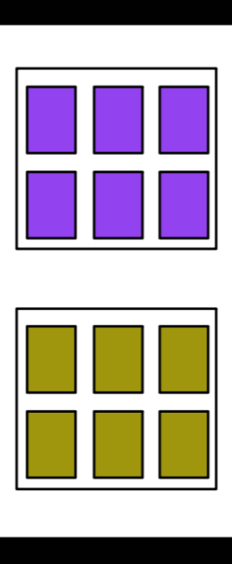
Conjoining Gestalt
Independent rules
Different interpretations
Complex interactions
Input
Horizontal
regularity
Vertical
regularity
Both
Notes:
Gestalt principles are stated independent rules.
When the input has different interpretations, it means that there are interactions between different rules,
This is called conjoining Gestalts.
For example the middle part of the window, you may group the elements either in horizontal (click) or in vertical (click), or (click) even both.
Here elements in same group are coded with same color.

Slide 13
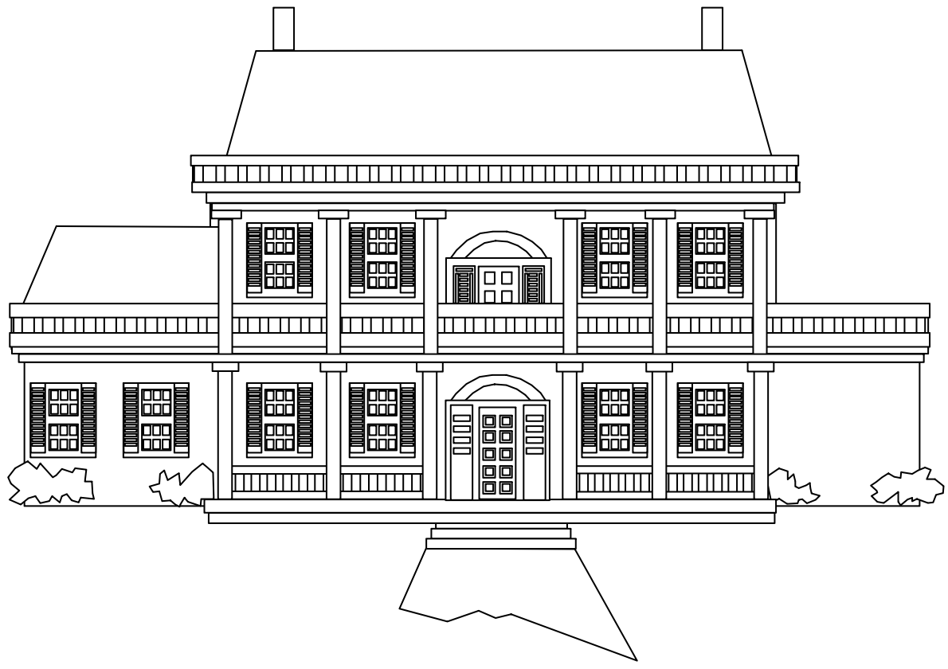
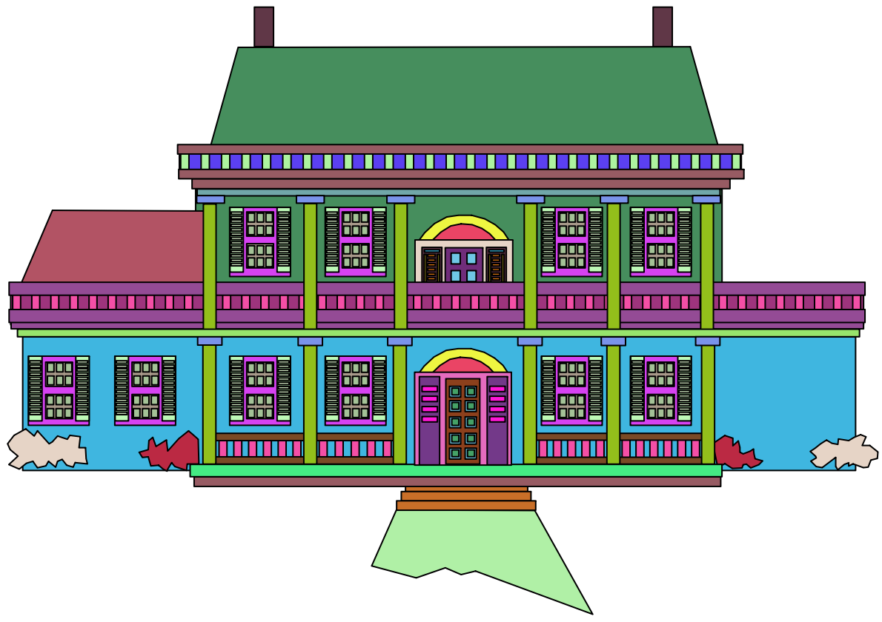
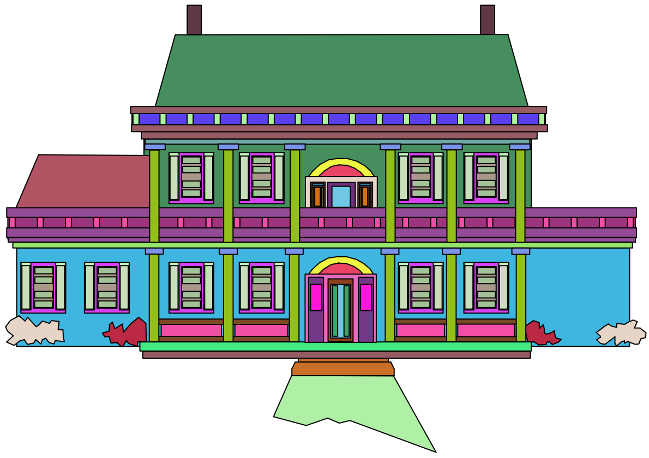
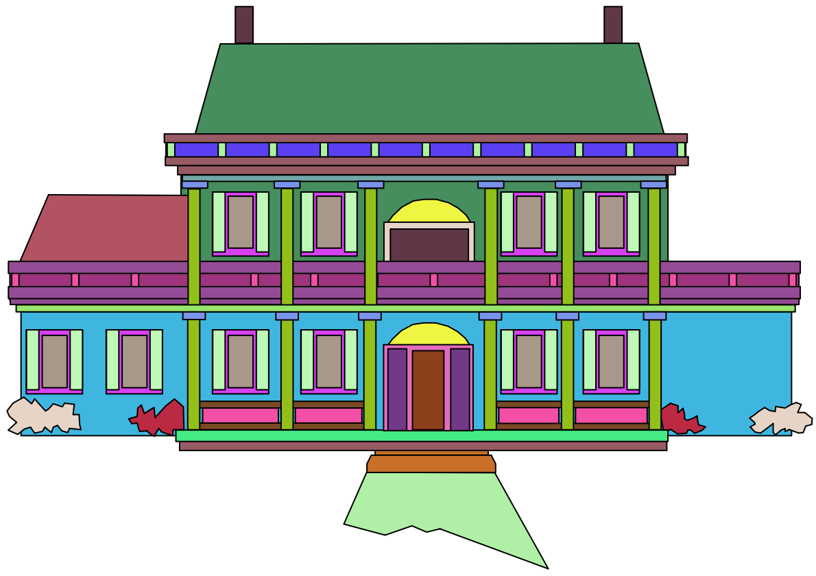
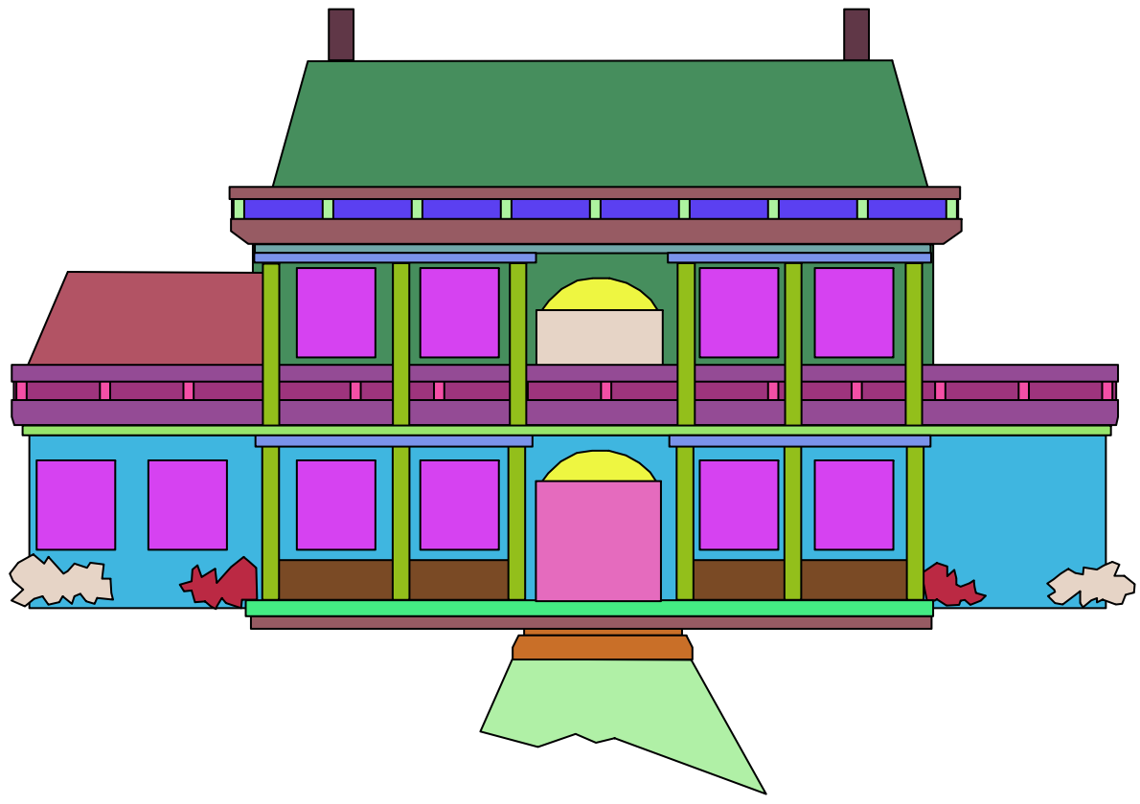
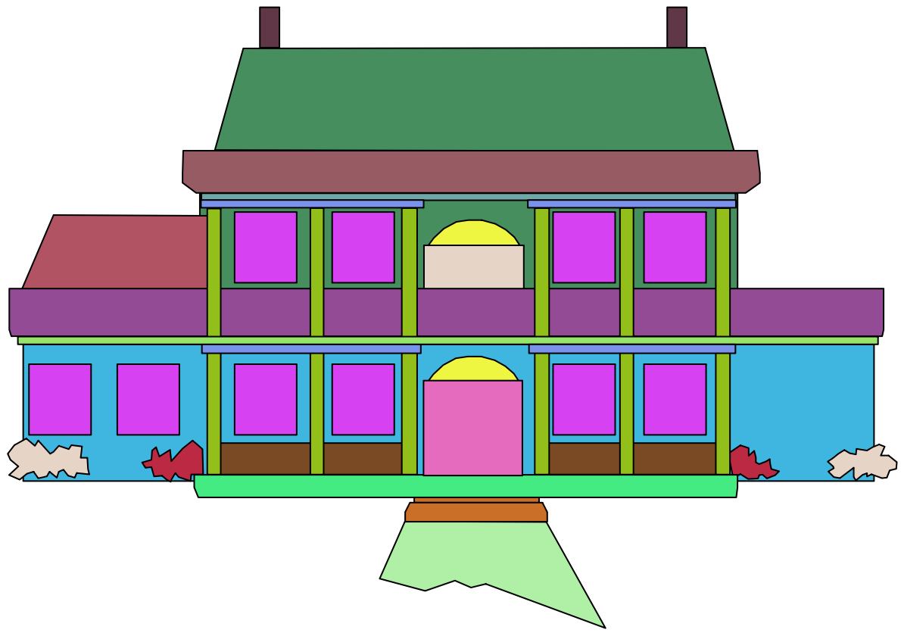
Contributions
Computational framework
Abstraction of architectural drawings
Notes:
In this work, we develop a computational framework, which models the conjoining Gestalt for abstraction of architectural drawings.
(click) When we find a dominant gestalt, We simplify it in the drawings as you can see here.

Slide 14
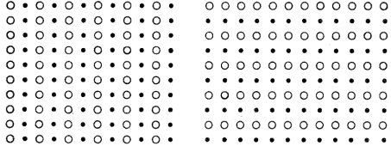
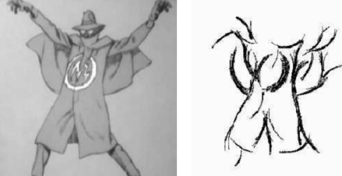
Related Work
Qualitative and empirical studies [Wertheimer 1923]
Quantification of Gestalt principles and their interactions
[Desolneux et al. 2002], [Cao et al. 2007],
[Kubovy and Van den Berg 2008]
Perceptual principle based abstraction – No conjoining
[DeCarlo and Santella 2002],
[Barla et al. 2005; 2006],
[Mi et al. 2009]
Notes:
Here are some related work on Gestalt theory and abstraction.
Earlier psychological works focused mainly on qualitative studies. (click) Only few recent works studied quantification of Gestalt principles and their conjoining.
(click) Using perceptual principles, [DeCarlo and Santella] computed image abstraction by preserving meaningful structures. They do not address the complex interactions between different gestalt rules.

Slide 15
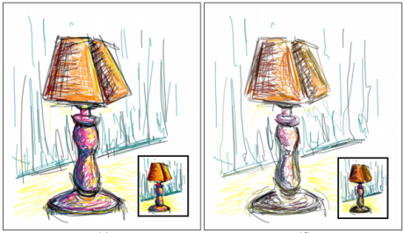
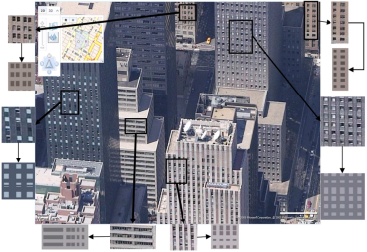
Related Work
Stroke density based simplification – structures are broken
[Grabli et al. 2004], [Shesh and Chen 2008]
Building representation – limited to regular patterns
[Loya et al. 2008], [Adabala et al. 2009]
Quantification and interaction of Similarity & Proximity
[Kubovy and van den Berg 2008]
Challenge: interaction of multiple Gestalt principles
Notes:
[Shesh and Chen] simplify line drawings by measuring the stroke density. This method can obtain simplification at interactive speed. But the structure of the drawings maybe broken in very coarse levels.
(click) For images of buildings, some work computed abstractions by straightening edges. This method is limited to regular patterns.
(click) Recently, [Kubovy] explored the quantification and interaction of two Gestalt principles: similarity and proximity. However, modeling the interaction of multiple Gestalt principles still remains a challenge.
Inspired by this work, we develop a computational framework which models conjoining Gestalt.

Slide 16
Our Solution
Conjoining Gestalts ↔ Consistent segmentation
Subset of Gestalt principles
Our method
Energy minimization
Graph-cut solution
Notes:
Resolving conjoining gestalt is equivalent to finding a consistent segmentation of the elements into groups.
Here consistence means that the segmentation should comply with gestalt principles.
Currently we choose to model the interactions between a subset of gestalt principles. They are regularity, proximity and similarity. All these principles are very common in architectural drawings.
We formulate the grouping problem as energy minimization and solve it using multi-label graph cut.
Now let me introduce how we build the computational framework, and our solution.

Slide 17
Overview
Input
Initial groups
Optimal groups
Abstraction
Notes:
Before going to the technical details, let me first show you an overview of our method.
Given an input, we first detect initial groups using different Gestalt principles. Then we find the optimal groups by graph-cut optimization. And finally we apply some abstraction operators to obtain the simplification.

Slide 18
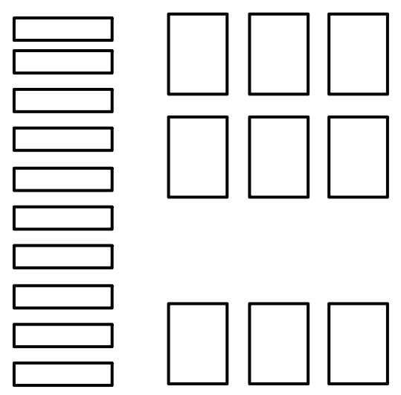
Proximity Graph Structure
Notes:
Let’s take part of this detailed window to illustrate how our method works.

Slide 19
Proximity Graph Structure
Spatial relation graph
Element → node
Connect neighbors by edges
Notes:
We first construct the spatial relation graph by proximity.
In the drawings each element corresponds to a node (click) in the graph.
For each element we find its k-closest neighbors and connect the corresponding nodes in the graph (click) with edges.

Slide 20
Optimization via Graph Cut
Initial groups → labels
Notes:
Then we loosely detect initial groups based on Gestalt principles.
These initial groups will serve as graph labels in our graph-cut formulation.

Slide 21
Optimization via Graph Cut
Initial groups
Proximity groups
Notes:
Proximity labels are computed by detecting groups of connected elements in the graph with edge lengths below a threshold.
Here we have three initial groups for proximity.

Slide 22
Optimization via Graph Cut
Initial groups
Similarity groups
Notes:
Similarity labels are computed by detecting groups of elements which share high level of similarity.

Slide 23
Optimization via Graph Cut
Initial groups
Regularity groups
$$L_{1}^{R}$$
Notes:
We define regularity gestalt as a group of elements that are positioned at regular intervals along horizontal and vertical directions. Here we have four initial groups for regularity Gestalt.

Slide 24
Optimization via Graph Cut
Goal : find the optimal groups
Grouping → Energy minimization
Proximity groups
Similarity groups
Regularity groups
Notes:
Ok now we have three types of initial groups for this window.
Some initial groups can overlap and conflict with each other. In the right part of this window(click), proximity, similarity and regularity groups conflict. They can not co-exist.
(click) Our goal is to find the optimal groups which comply with Gestalt principles.
We formulate the grouping problem as energy minimization.

Slide 25
Optimization via Graph Cut
Energy minimization – function terms
Data cost
Notes:
Our energy function consists of three terms.
(click)The first term is the data cost term.

Slide 26
Optimization via Graph Cut
Energy minimization – function terms
Data cost
Assigned for different Gestalt labels
Penalty of assigning a label to an element
Notes:
Since an element can potentially belong to several Gestalts, we assign it a data cost term for different Gestalt labels. This term measures the sum of penalty of assigning a label f to an element p.

Slide 27
Optimization via Graph Cut
Energy minimization – function terms
Data cost for Regularity
Alignment
Notes:
Regularity data cost measures how regular the elements are aligned in the group.

Slide 28
Optimization via Graph Cut
Energy minimization – function terms
Data cost for Similarity
Average shape similarity
Notes:
Similarity data cost is defined by the average shape similarity of the group.

Slide 29
Optimization via Graph Cut
Energy minimization – function terms
Data cost for Proximity
Closest distance of the elements to the group
Notes:
Proximity data cost is simply defined as the closest distance of the elements to the group.

Slide 30
Optimization via Graph Cut
Energy minimization – function terms
Smoothness cost
Notes:
The second term in the energy function is the smoothness term.

Slide 31
Optimization via Graph Cut
Energy minimization – function terms
Smoothness cost
Spatial correlation of neighboring elements
p, q - neighboring elements
Notes:
This term measures the spatial correlation of neighboring elements.
(click) It is intuitive that elements with a smaller distance and higher shape similarity will have higher probability of belonging to the same group.

Slide 32
Optimization via Graph Cut
Energy minimization – function terms
Label cost
Notes:
The third term in the energy function is the label cost term.

Slide 33
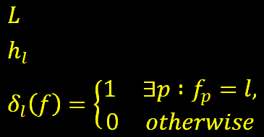
Optimization via Graph Cut
Energy minimization – function terms
Label cost
Penalty for over-complex groups
Concise explanation of the inputs
- set of labels
- non-negative label cost for different Gestalt
Notes:
This term penalizes over-complex groups and favors to explain the input with fewer and cheaper labels.
{ for Q & A:
(hl is a non-negative label cost of label l and δ() an indicator function)
a. For proximity gestalts, label cost is measured by the inverse density defined as the area difference between the union of shapes and their convex hull.
b. For similarity gestalts, label cost is defined by shape similarity variance against an arbitrary shape within the gestalt.
c. Regularity label cost is measured as the inverse density multiplied by the elements distance variance from the perfect frequency pattern and inverse number of elements.
Note, all the terms are normalized between [0, 1]
}

Slide 34
Optimization via Graph Cut
Overall energy function
Labeling → minimization
Multi-label graph-cut [Delong et al. 2010]
Data cost
Smoothness
cost
Label cost
Notes:
With all these terms defined, we have the overall energy function.
Finding a solution to this labeling problem is equivalent to the minimization of this function.
(click) We solve it using a multi-label graph-cut proposed by [Delong et al. 2010].

Slide 35
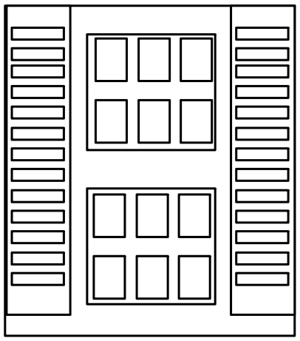
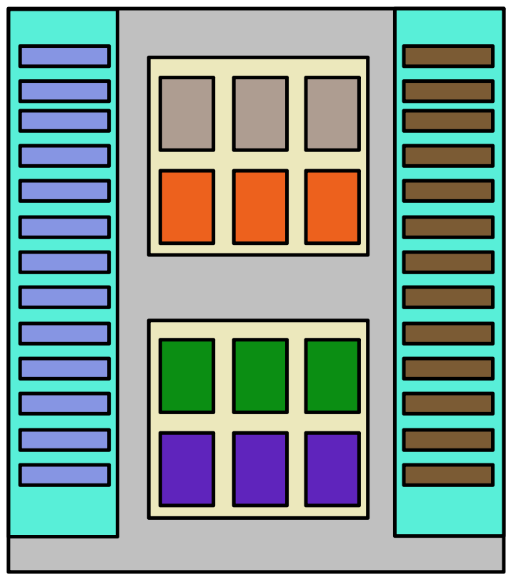
Optimization via Graph Cut
Groupings complying with Gestalt principles
Notes:
After the minimization, we find appropriate groupings that comply with Gestalt principles.
Here in this figure the optimal groups are coded with different colors.

Slide 36
Computation Results
Regularity VS. Proximity
Speed x0.5
Notes:
This video shows our computational result of the interaction between regularity and proximity.
At the beginning, the vertical regularity Gestalt is the dominant grouping(click on video).
But when we interactively move some elements to the top-left corner, the proximity Gestalt wins over the vertical regularity.

Slide 37
Computation Results
Proximity VS. Similarity
Notes:
And here shows the interaction between proximity and similarity.
(click on video) Due to the smaller neighboring distance, the vertical proximity dominates at the beginning.
When we decrease the rectangle similarity between the two rows, the horizontal similarity Gestalt wins.

Slide 38
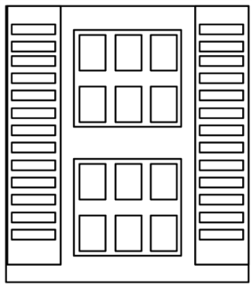
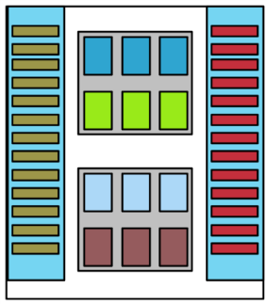
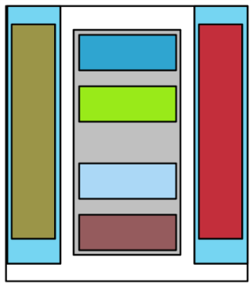
Visual Abstraction
Abstraction Operators
Embracing
Summarization
Notes:
For architectural drawings, we propose two types of operators for visual abstraction.
(click) One abstraction operator is embracing. It replaces a group of elements with a simplified enclosing shape. We use the convex hull for embracing.
(click) Another operator is summarization. It represents a group of repeated elements with a smaller number of elements.

Slide 39
Level of Detail
Progressively simpliﬁed results
Notes:
Be applying the abstraction operators in progressive manner, (click) we can generate a sequence of simplification for the input.
In our implementation we do the abstraction when we zoom out the drawings. But here we show them whit original size, and also code the elements with colors, so it is easy to see how elements get grouped.

Slide 40
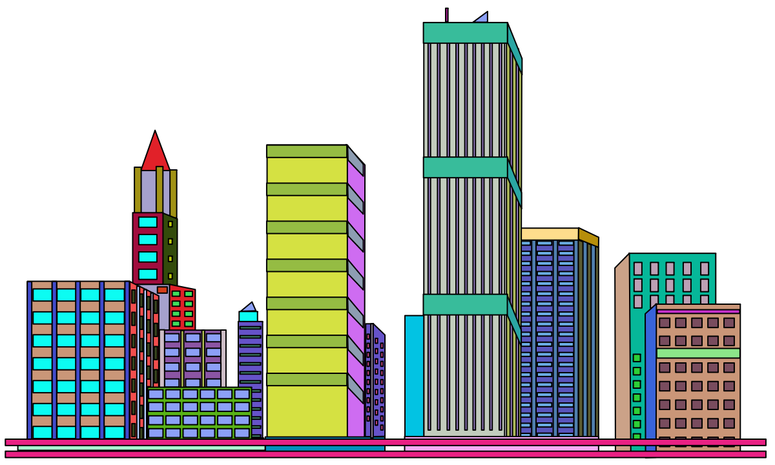
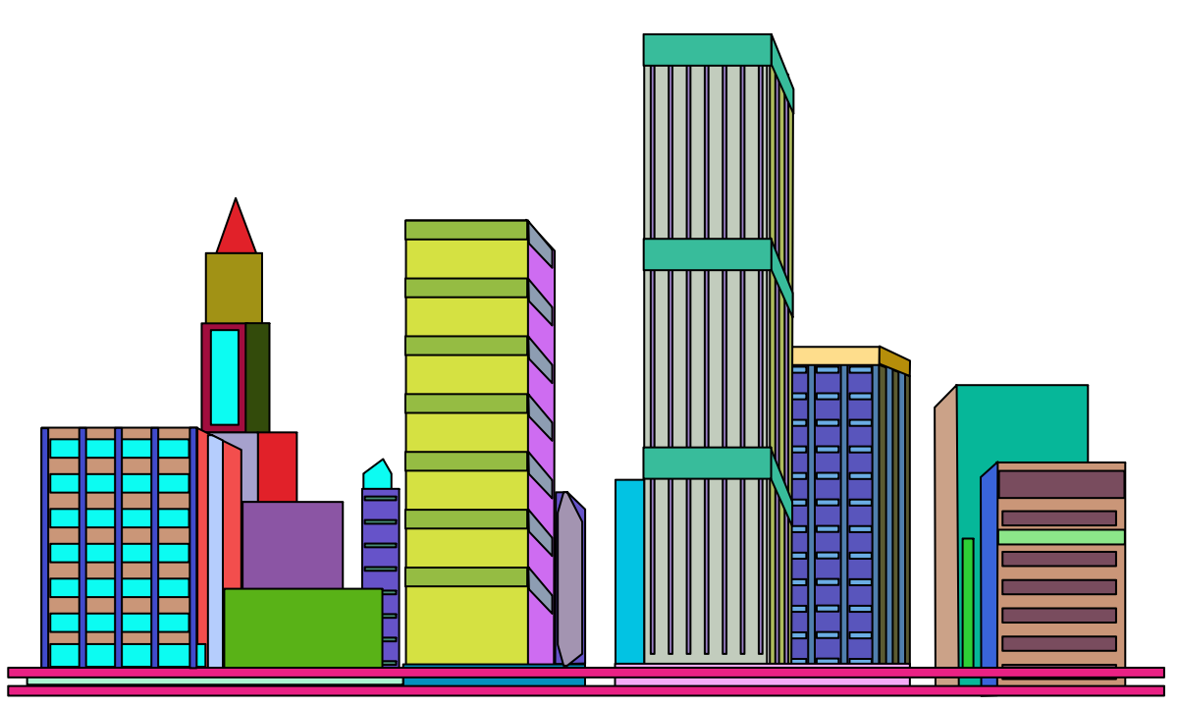
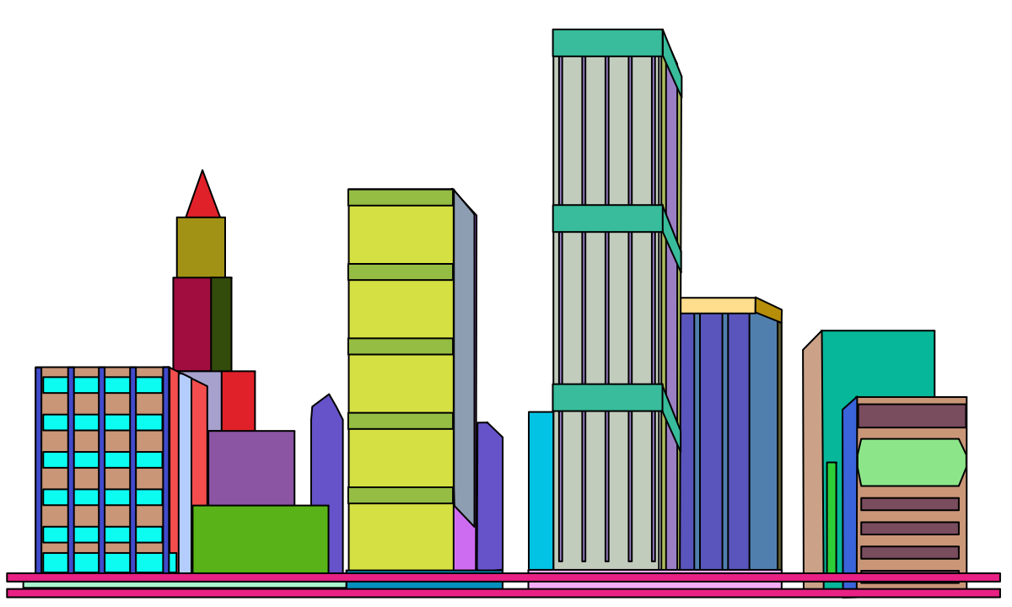
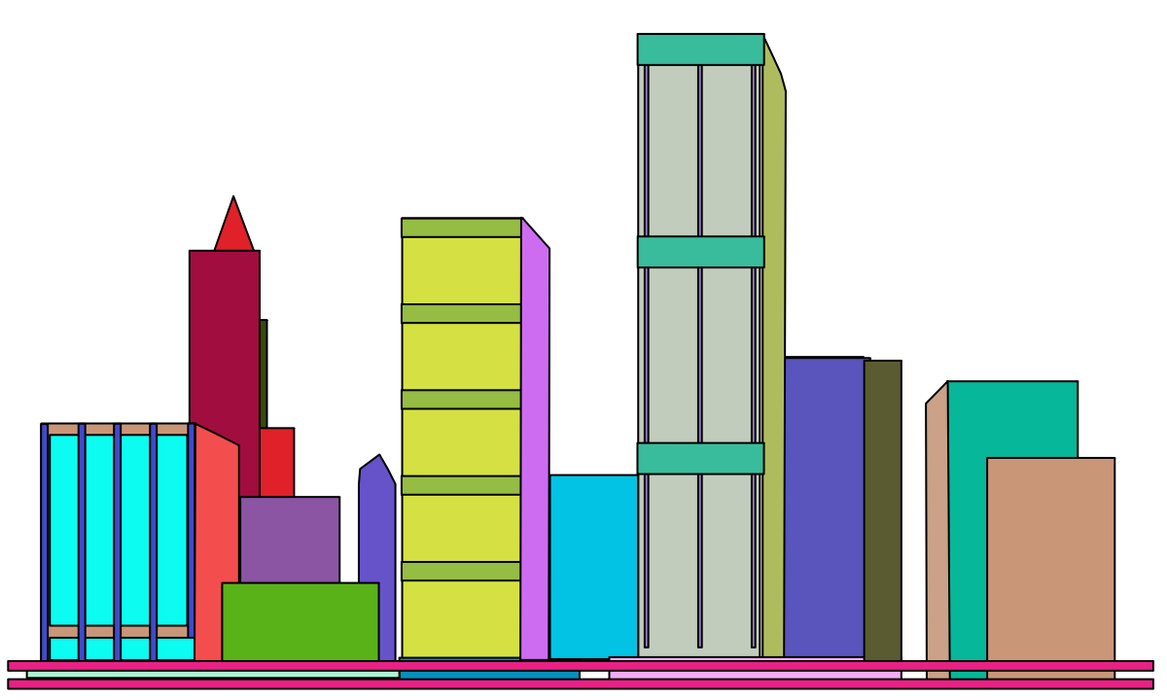
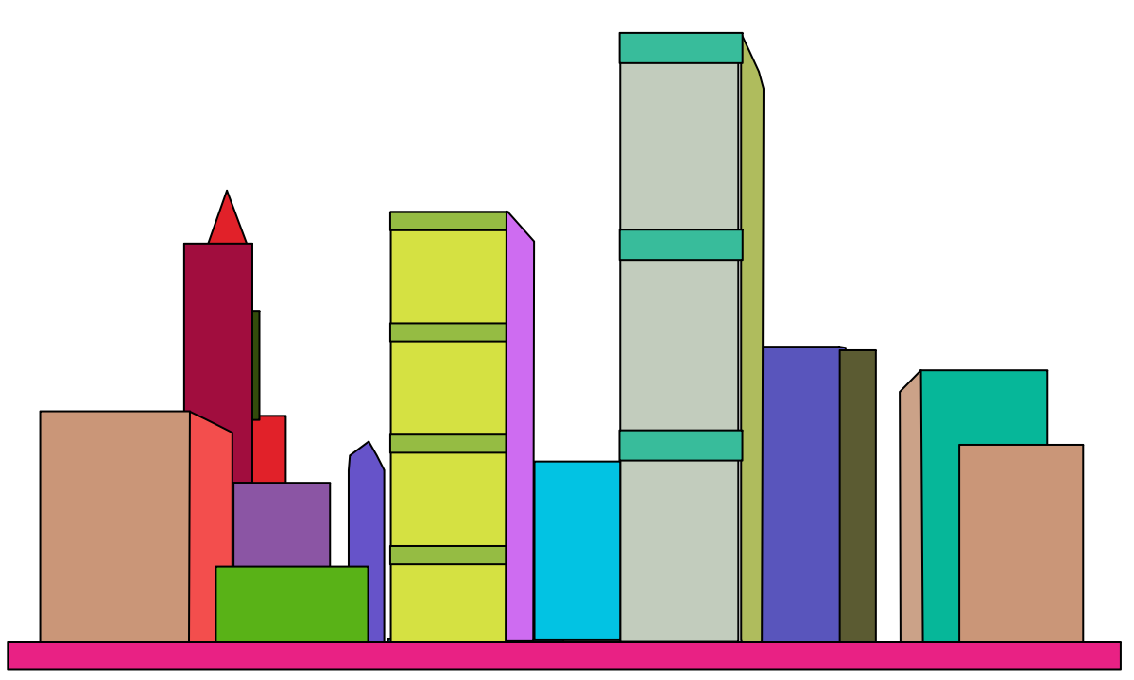
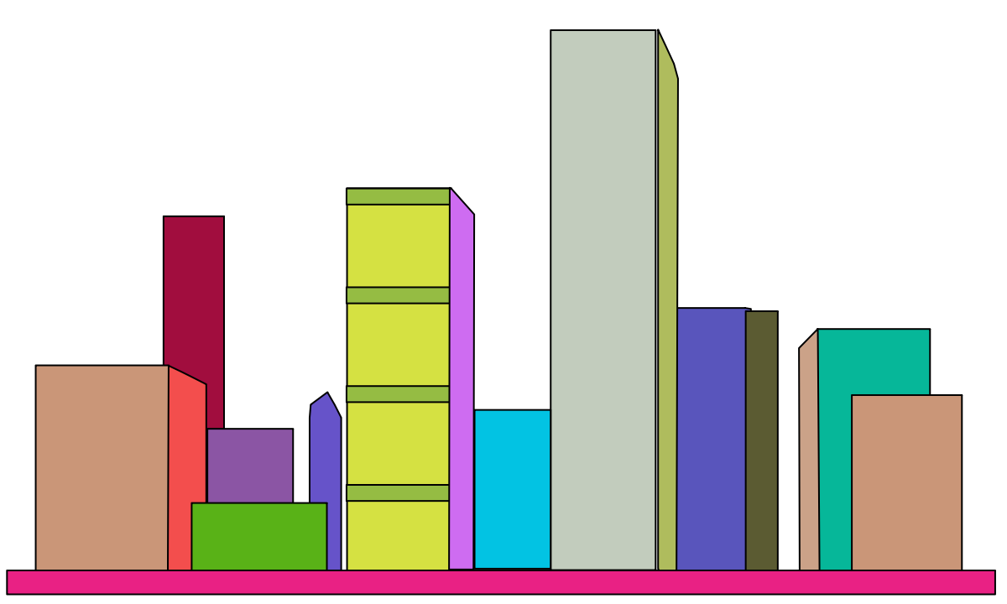
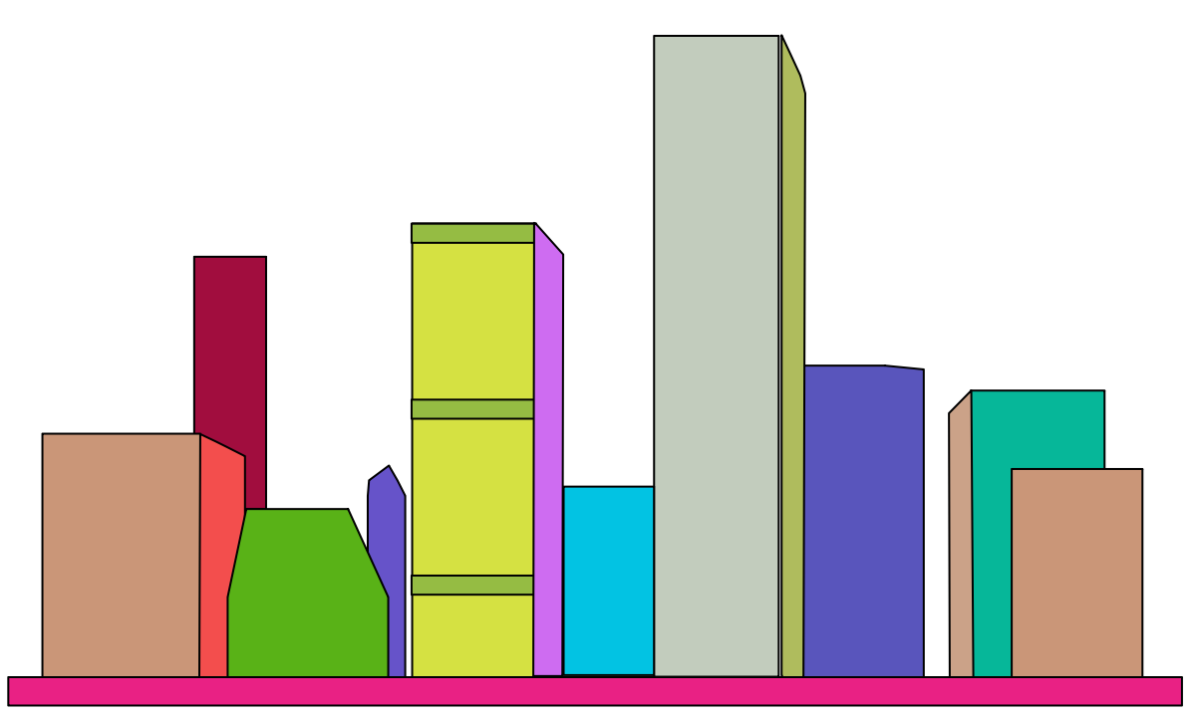
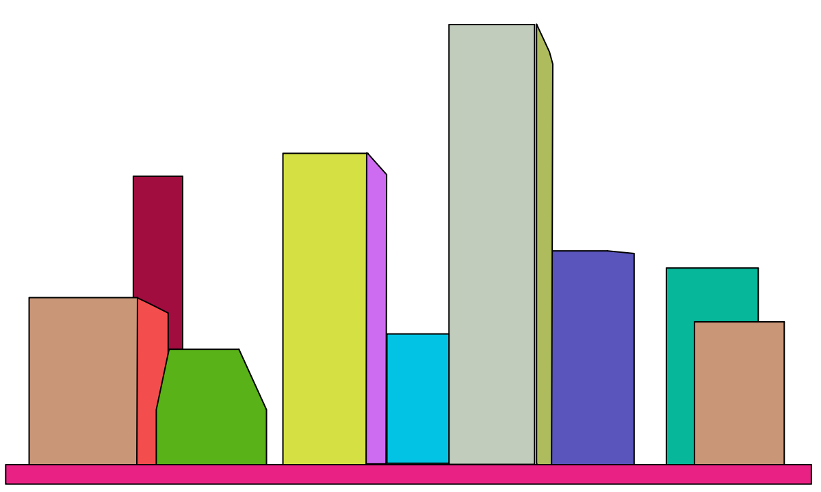
Results
Notes:
Here is an abstraction sequence of a city scene, also coded with color.
Note, the structure of the buildings are meaningfully preserved.

Slide 41
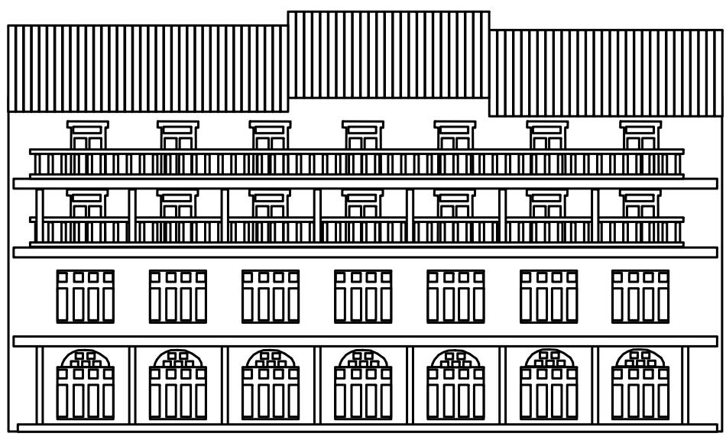
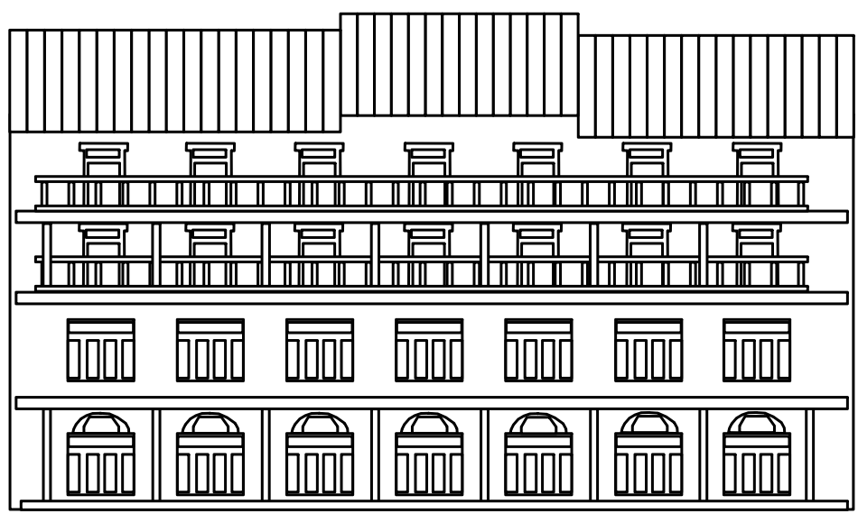
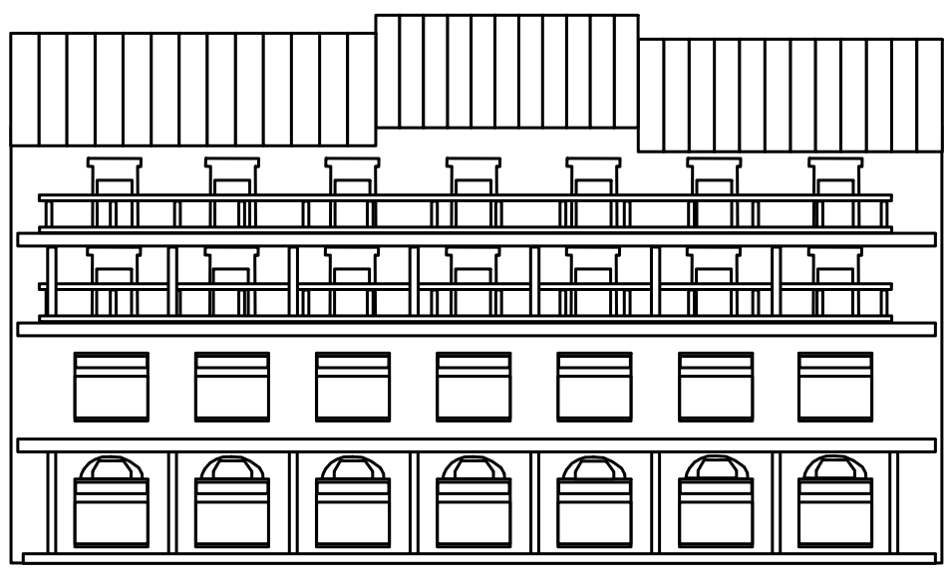
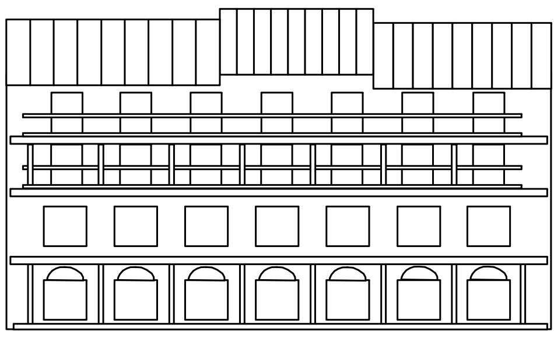
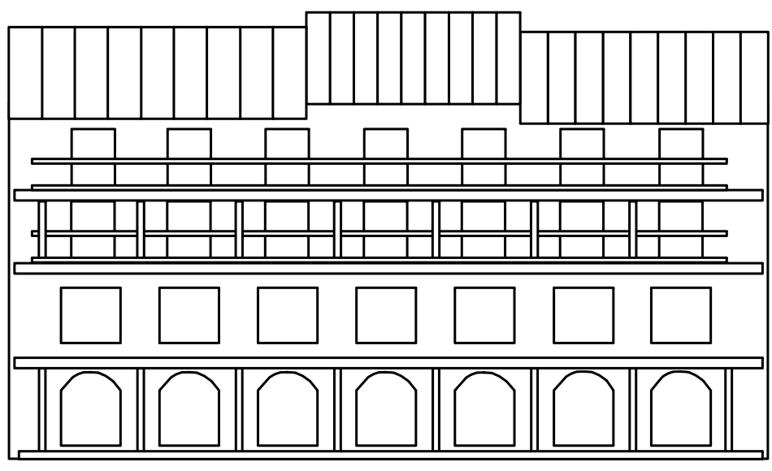
Results
Notes:
In this example, the railings and doors overlap.
However, their interaction is solved as railings are grouped by regularity Gestalt (click).

Slide 42
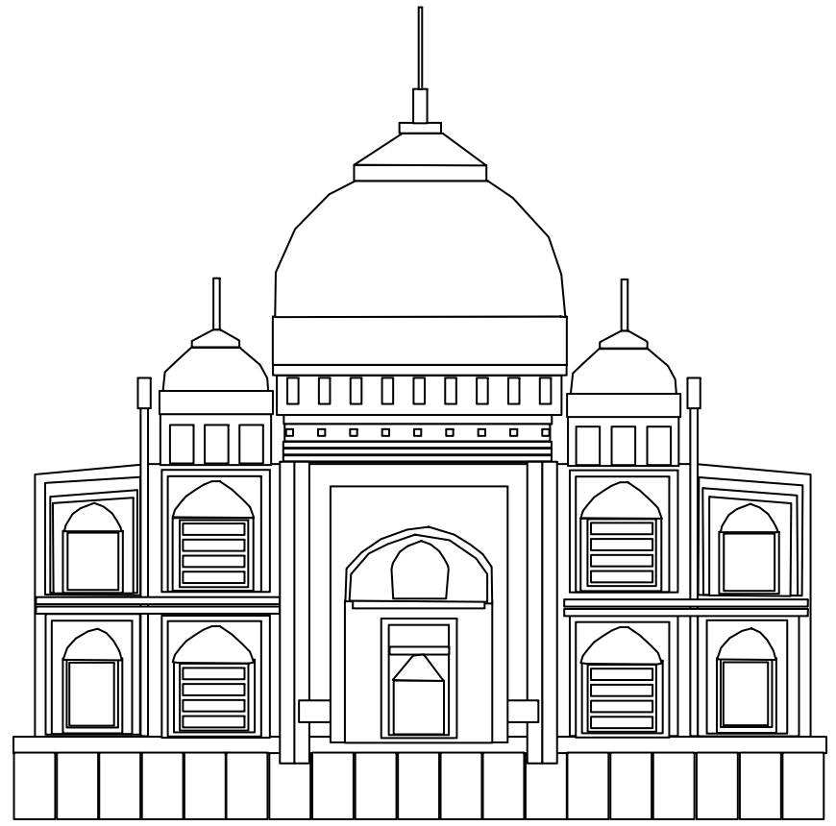
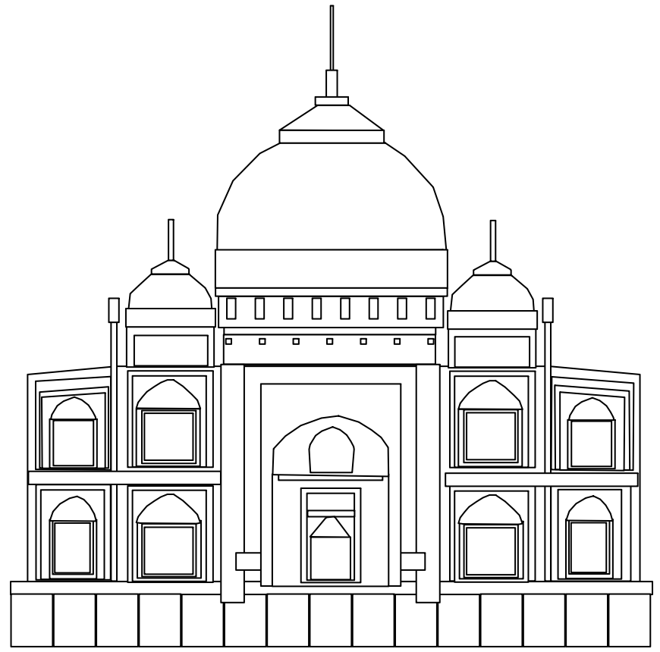
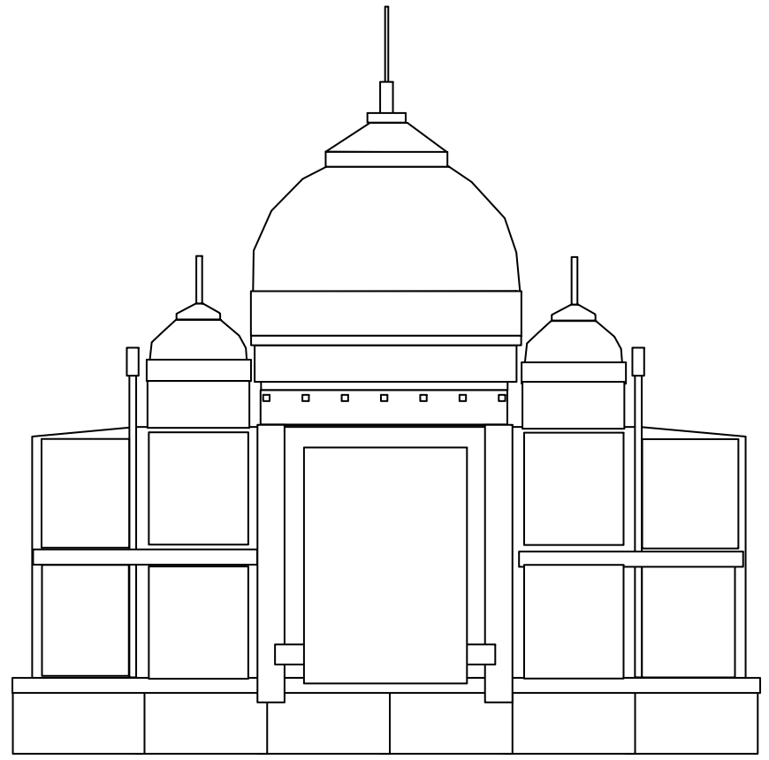
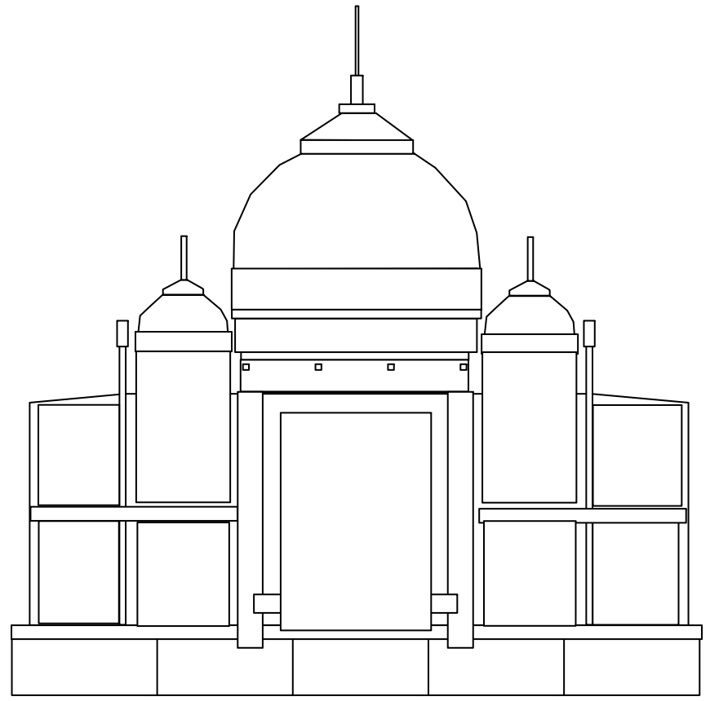
Results
Notes:
This is the abstraction sequence of the Taj Mahal.

Slide 43
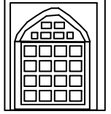
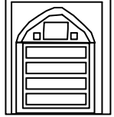
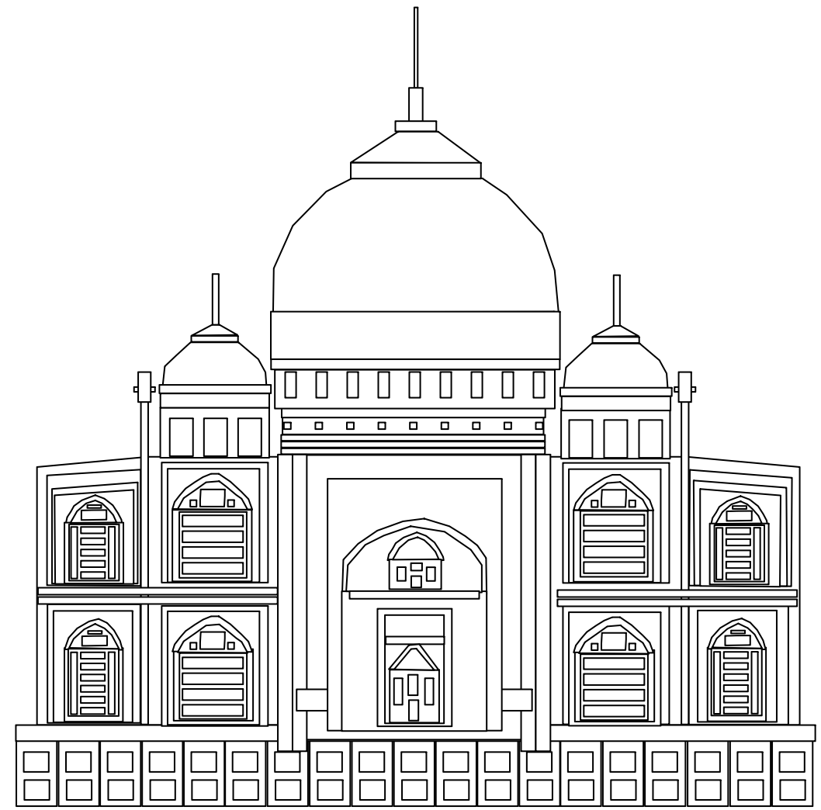
Results
Notes:
Because of shape similarity, the 4 out of the 6 small elements in the inner windows get simplified by embracing shapes.

Slide 44
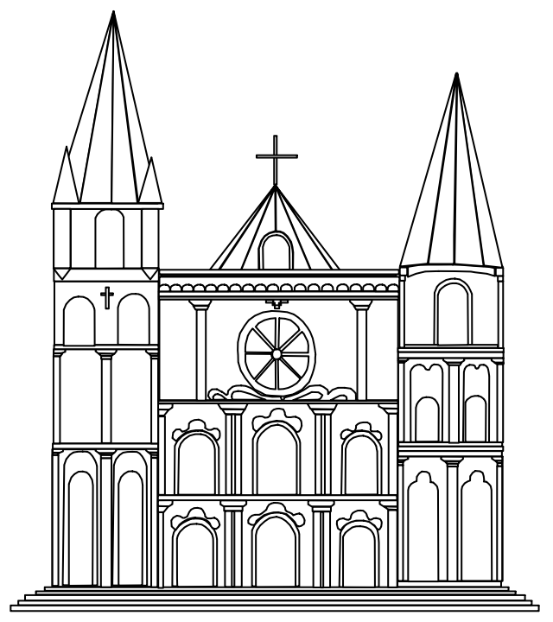
Results
Notes:
Here is another abstraction sequence for a church drawing.

Slide 45
Results
Notes:
It is interesting to see that the central Rosetta Window gets simplified in a highly symmetrical manner.

Slide 46
Extension to Mosaics
Additional continuity & closure Gestalt
Notes:
Beside the architectural drawings, we also attempted to extend our computational framework to drawings of organics objects.
(click) Here shows the abstraction of a fish mosaics.
For this example, the additional continuity and closure Gestalt are used.

Slide 47
Extension to Mosaics
Notes:
This is another result for flower.
Note, for all these abstractions, the structures of the input are well preserved.

Slide 48
Conclusion
Computational framework
Conjoining Gestalt principles
Energy minimization, Graph-cut solution
Abstraction of architectural drawings
Effective
Preserving structure
Extension to mosaics
Notes:
OK now, let me conclude the talk.
- We developed a computational framework that models the conjoining Gestalt.
We formulated the grouping problem as energy minimization and solved it using multi-label graph cut.
- The effectiveness of the proposed computational framework has been demonstrated in abstraction of architectural drawings. Our method preserves the structure of the drawings.
- Moreover, we extend the framework to simplify drawing of more general objects, which are illustrated on mosaics.
We need to say that our work is still the first attempt to modeling the complex conjoining Gestalt. We will continue to benefit findings from psychological domain.

Slide 49
http://web.siat.ac.cn/~vcc/publications/2011/gestalt_abstraction/
Notes:
Thank you for your attention!

